Slide 1
MTI KNOWLEDGE
February 19, 2019 St. Petersburg

Slide 2
BACKGROUND
MTI maximizes member asset performance
by providing global leadership in materials technology for industrial processing companies to improve safety, sustainability, reliability and profitability.
MTI Vision: MTI will be the process industries’ first choice for materials technology networking and solutions.
MTI Goals: To Increase and Maintain Member Diversity; Expand Our Network to Serve Our Worldwide Membership; Increase the Value of Participation; and Excel at Communicating the Value of MTI Membership.

Slide 3
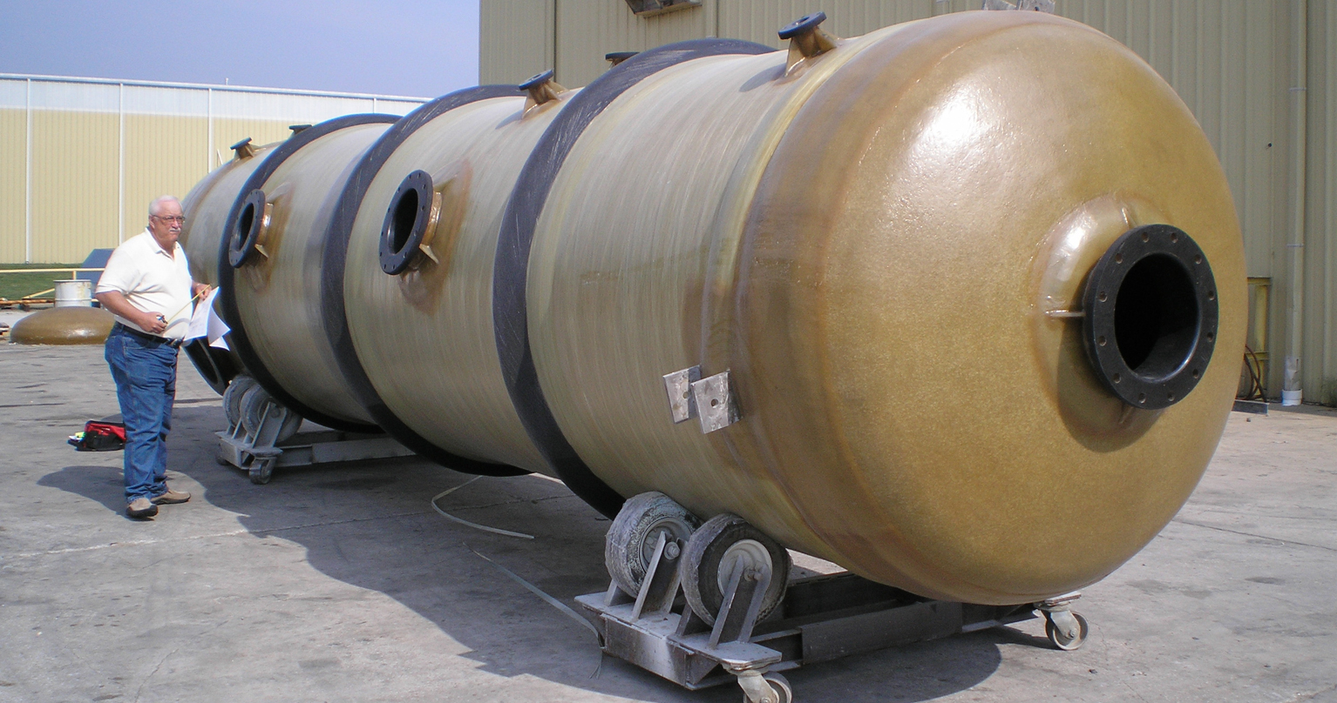
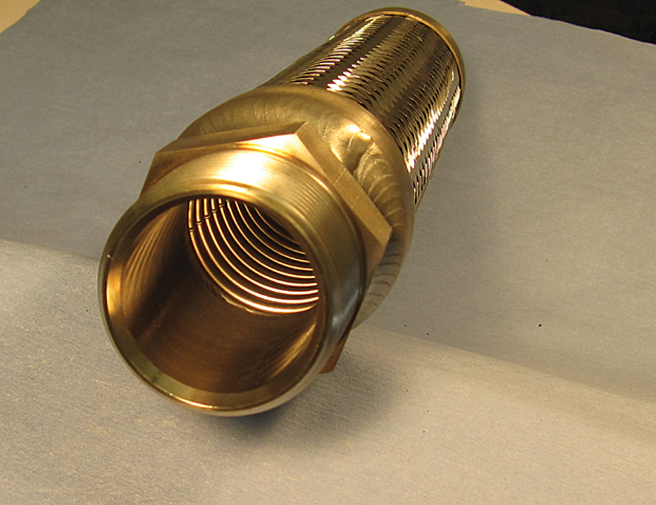
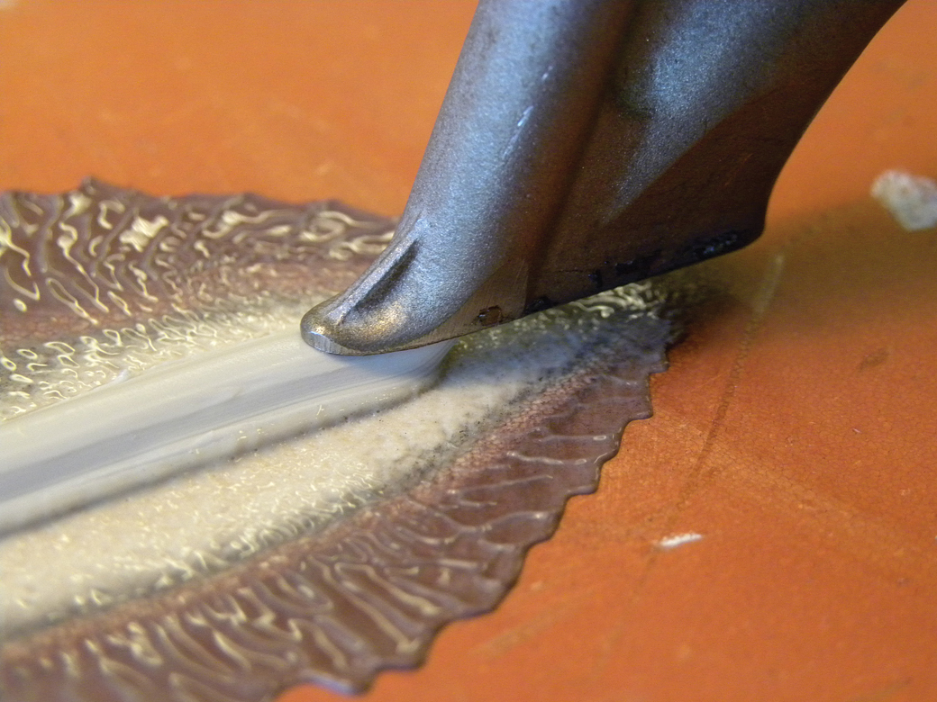
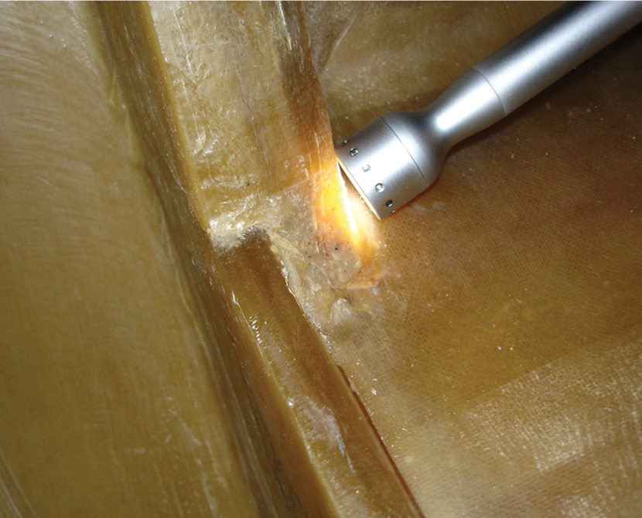
TYPES OF MTI KNOWLEDGE
Projects – results and reports
The MTI web site and TAC meetings
Expert MTI presentations and seminars
Expert MTI training
Social contacts with expert participants
Protected IP – patents, trade secrets and copyrights
Sense of future and industry trends

Slide 4
CONSENT TO USE PROTECTED INTELLECTUAL PROPERTY
Contractors and presenters must secure consents from any relevant owners of patents and copyrighted Materials for use in project or presentations, and they must also consent, for MTI and our members to have rights to use.
Model consent is on MTI web site.
“Fair Use” Doctrine also permits limited use for research and other purposes.

Slide 5
PATENTS & POSSIBLE COMMERCIAL DEVELOPMENT
MTI By-Laws – Members have royalty-free rights to patents developed by MTI.
Unless BOD, to facilitate commercial development, grants license to a potential developer.
RFID Patent and License
Members then benefit through MTI licenses bearing reasonable royalties.

Slide 6
USE OF MTI KNOWLEDGE
By members
By service and supplier members.
By joint ventures.
By consultants.
By non-members.

Slide 7
USE BY MEMBERS
Exclusive access to:
Web Forum and TACs
Right to propose projects
Right to join resource groups
Have advance use of final report
All to exclusion of non-members

Slide 8
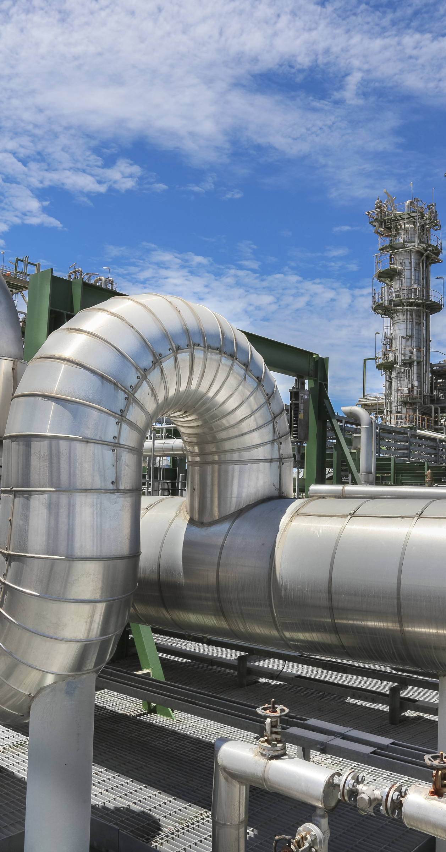
SPECIFIC MEMBER USES
Right to use company-wide
Including contractors on-site
Right to copy and summarize
Further “Company-Proprietary” use
Right to use as a standard
Right to send others to attend
All to exclusion of non-members

Slide 9
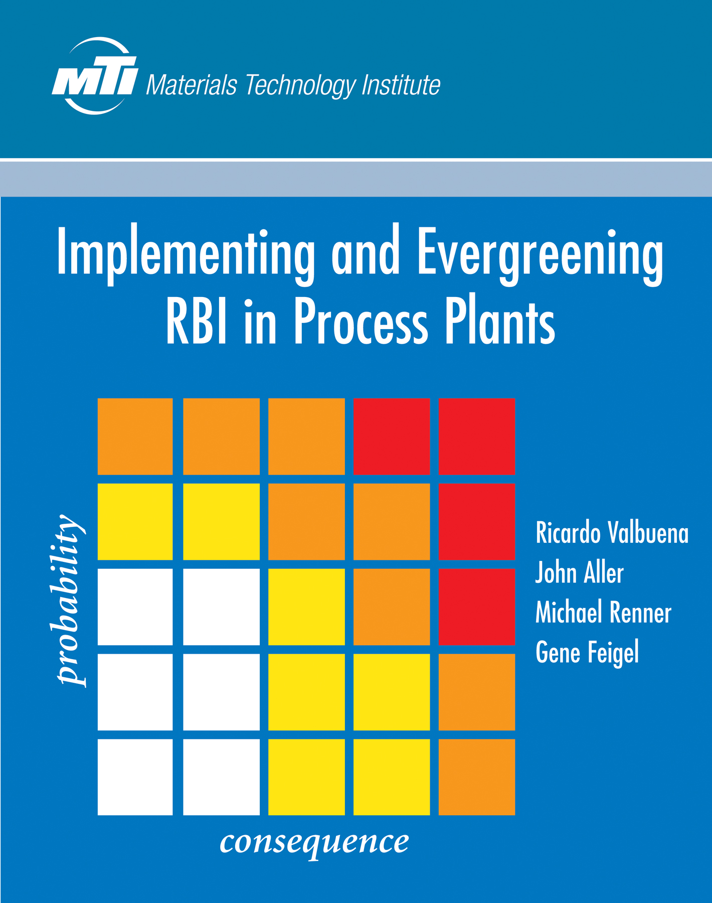
MEMBER PREFERRED ACCESS
Typically 12-18 months after distribution of final report
Then available for purchase
Out of print — Linda Hall Library http://www.mtiproducts.org/oumtipu.html
Full rights = Join MTI!

Slide 10
USE BY MEMBERS
Can use MTI knowledge for member and non-member consulting
But cannot share MTI documents or software with anyone not a member
Service affiliates of full-dues members can use throughout their membership
IP does not leave with employee upon retirement/termination

Slide 11
USE BY JOINT VENTURES
Principle: JV’s whose sales are included per GAAP rules in the member’s sales and are part of their dues basis have rights to MTI IP
JV is an MTI member with dues based on its own sales: Full member privileges, but may not share MTI IP with non-member parents. Has its own vote.
JV is not a member, but is owned >50% by an MTI Member: Has access to MTI IP, but may not share it with non-member parents. No separate vote.
JV is 50% or less owned by an MTI member: No member privileges. Member may not share MTI IP with the JV. (Same if 2+ members total >50%.)
Exception: Variable interest equity JV (not common)

Slide 12
USE BY CONSULTANTS
Access Equal to MTI Member for Consultant’s Own use to advise its appointing member.
Non-member access only for any other use by consultant.
Obviously difficult to distinguish.
Return materials upon end of contract
Consultants must agree to these restrictions.

Slide 13
USE BY NON-MEMBERS
MTI knowledge is members only.
Not to be distributed to non-members, contractors, or consultants in any form until MTI has made it available for sale.
Then available for purchase by non-members, never free use.

Slide 14
OVERSIGHT
The Designated Rep and TAC Rep should ensure that MTI knowledge is not distributed beyond appropriate company employees and Consultants, make all company employees and consultants who receive MTI knowledge aware of the confidential nature of the information being distributed, and inform the TAC Chair of any issues or questions.

Slide 15
COMMUNICATE MTI VALUE
MTI knowledge is of great value to you and your company.
Circulate that knowledge far and wide.
And communicate the expectations.
Make your “Budget Holders” aware.
Anecdotes and specific savings.
More awareness = More value and more continued participation.

