Slide 1
Project Development
From Problem to Solution

Slide 2
MTI MISSION
MTI maximizes member asset performance by providing global leadership in materials technology for industrial processing companies to improve safety, sustainability, reliability and profitability.

Slide 3
ROLES & RESPONSIBILITIES
Designated Representative (DR)
TAC Representative (TR)
Project Development Committee (PDC) Leader or Member
Project Team (PT) Champion or Member
Board of Directors (BOD) Member

Slide 4
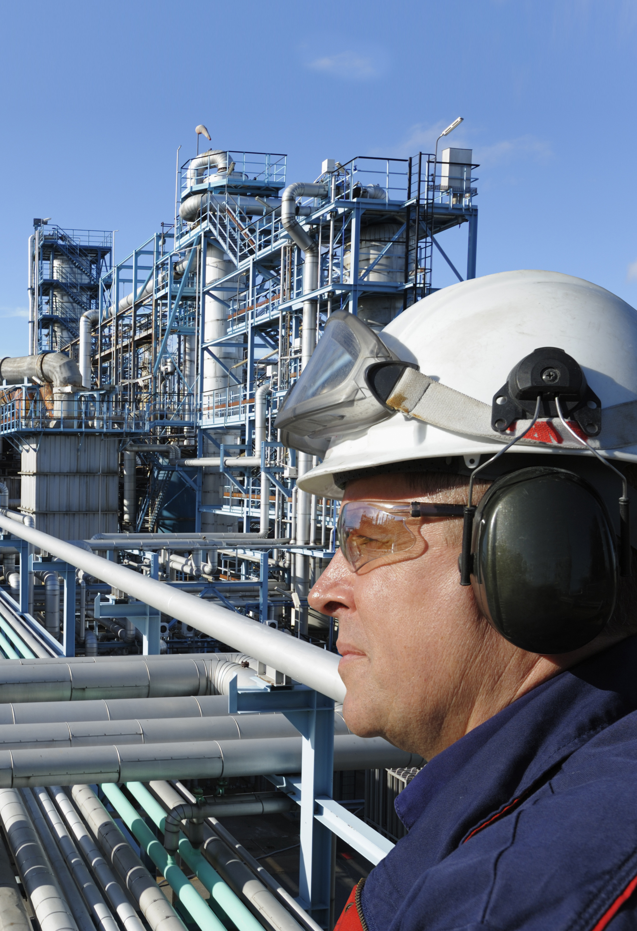
Project Development Committees
Knowledge Management
Materials Degradation
Integrity and Condition Assessment
Metals
Polymers
Ceramics

Slide 5
THE MTI PROJECT PROCESS
PDCs stimulate and develop ideas that may become potential projects if they fulfill the MTI Mission and Vision.
Other projects originate from forum topics, open discussions or other presentations.
Project proposals from outside sources are not encouraged.
The projects are not “staff-driven,” but require “Champions.”
Staff members help make it happen.

Slide 6
THE MTI PROJECT PROCESS
The BOD gives final approval to fund projects.

Slide 7
CULTURE ELEMENTS
Element 4: Voting
In Favor... | if you believe that it furthers the MTI Mission has probable value has a sufficient probability of success
Against... | if you believe it does not meet the above criteria
Abstain... | if you cannot adequately evaluate the project
Recuse... | if you have a direct and significant conflict of interest
Remember... | always disclose non-obvious conflicts of interest one vote per Member company

