Slide 1
MTI CULTURE

Slide 2
MTI CULTURE
Expectations for organization beliefs, values, behavior and decision-making on our journey to the future MTI

Slide 3
CULTURE ELEMENTS
Element 1: Membership
All members are equal members of MTI with regard to privileges.

Slide 4
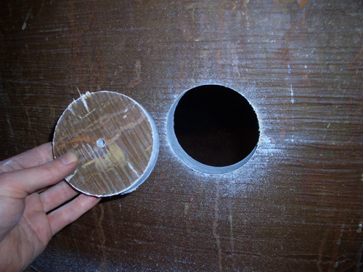
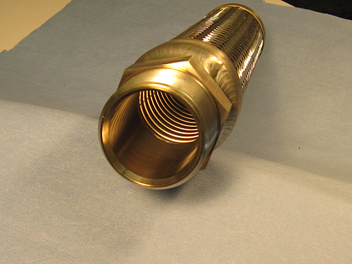
CULTURE ELEMENTS
Element 2: Projects
Projects must further the MTI Mission.
There is no “fair share of projects” expectation for groups within the MTI membership.

Slide 5
CULTURE ELEMENTS
Element 3: Value
MTI furthers the Mission.
Members derive value from the Mission results, and by being part of the process.

Slide 6
CULTURE ELEMENTS
Element 4: Voting
In Favor... | if you believe that it furthers the MTI Mission has probable value has a sufficient probability of success
Against... | if you believe it does not meet the above criteria
Abstain... | if you cannot adequately evaluate the project
Recuse... | if you have a direct and significant conflict of interest
Remember... | always disclose non-obvious conflicts of interest one vote per Member company

Slide 7
CULTURE ELEMENTS
Element 5: TAC Meetings
TAC Meeting participants wear the MTI Mission hat. Other hats are unavoidable, but in TAC meetings the MTI Mission hat is primary.
TAC Meeting participants understand and adhere to the MTI policy regarding commercial presentations.
MTI Staff members do not act as project advocates, but may act to bring pertinent information and knowledge into the discussion.
The TAC Chair has primary responsibility for maintaining appropriate behavior in TAC meetings.

Slide 8
CULTURE ELEMENTS
Element 6: BOD Meetings
BOD members understand and adhere to the Code of Ethics in the MTI Policy Manual.
The BOD appropriately considers the judgment of the TAC regarding a project’s value and technical merit. However, the BOD also considers additional considerations related to its responsibilities, such as funding limitations, organization strategy, legal considerations, etc.
BOD Members act in the interest of the organization without regard to the individual interests of their organization.

Slide 9
CULTURE ELEMENTS
Element 7: Meeting Behavior
Disagreement is okay and expected.
Respect and courtesy is maintained at all times, especially when disagreeing.
Discussion complies at all times with MTI policies regarding commercialism and legal considerations.
Meeting discussions are lively, interesting and fun.

Slide 10
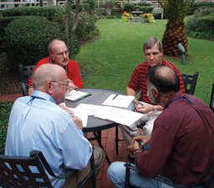
CULTURE ELEMENTS
Element 8: Social Behavior
Experienced meeting attendees make new attendees feel respected, included and valued.
Experienced meeting attendees include new attendees in social interactions.
Meeting attendees are approachable.

