Slide 1
MTI VALUE
BUILDING A CASE FOR MTI MEMBERSHIP

Slide 2
WHY UNDERSTAND YOUR COMPANY’S VALUE CASE?
To better justify MTI membership to someone with the spending authority to pay the dues.
To better create and deliver value to your company from MTI membership.
To help our MTI colleagues better understand how they can extract value from MTI and justify membership.

Slide 3
VALUE IS COMPANY-SPECIFIC
Members Cite Many Ways MTI Adds Value for Them
Networking
Access to industry experts
Online forum for problem solving
Technology projects
Building customer relationships
Better understanding customer needs
Visibility and image in the industry
Understanding RAGAGEP
Contributions to engineering standards
Continuing education credits for PE, NACE Certs

Slide 4
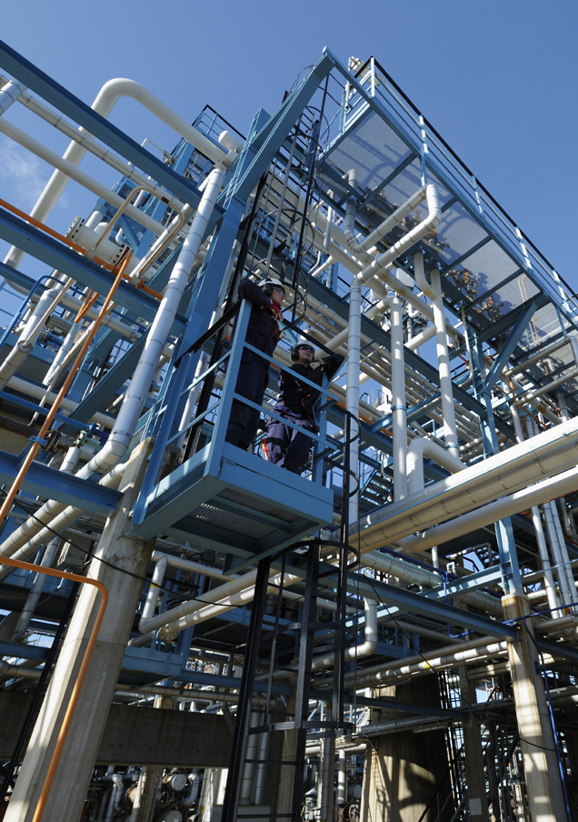
VALUE IS COMPANY-SPECIFIC
Your Company’s Value Case…
… is specific to your company.
… is what your decision-maker values.
… is the primary responsibility of the Designated Rep, but it is helpful to involve others in crafting it.

Slide 5
MTI TAC REP — DISSEMINATING MTI INFO

Slide 6
MTI TAC REP — USING MTI

Slide 7
SHARING
Sharing your value case with MTI staff and other member companies helps them strengthen their value case.
Sharing MTI participation inside your company builds support. The TAC Forum and project Teams are good low-cost ways to involve others.
Having more than one regular TAC attendee is helpful, particularly for the “hit-by-a-bus” scenario.

Slide 8
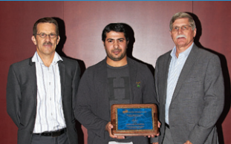
BE REWARDED FOR SHARING
Value Awards
Value Committee created in 2014 – Chairman Ed Naylor
First Global Value Award to SABIC in 2014 MTI’s Guidance for Plant Personnel in Gathering Data and Samples for Material Failure Analyses applied to a Reformer inlet tube failure investigation.
Five other Member Companies were recognized
2015 Grand Award winner TBA

Slide 9
MTI TAC REP — MAINTAINING SUPPORT FOR MTI
Who writes the check and what benefit from MTI does he/she value?
What valuable things does MTI do for others in my company?
Can I express MTI’s value as a dollar amount?
Is the right department paying the bill?

Slide 10
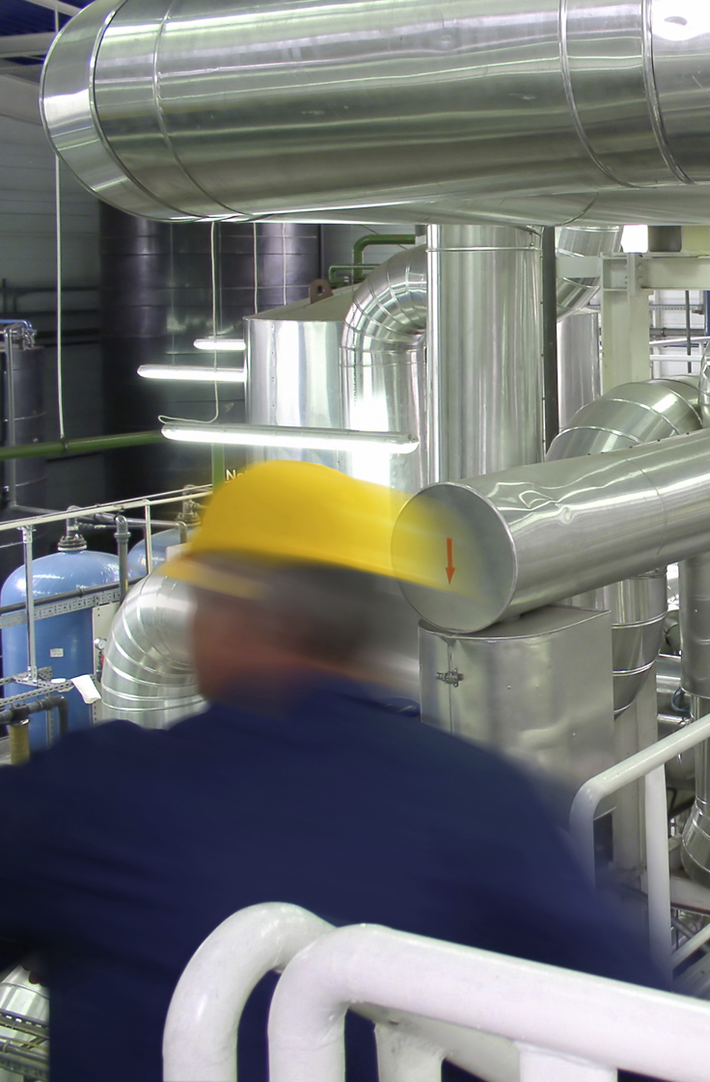
MTI STAFF CAN HELP
Facilitate sharing value cases.
Activity reports (attendance, project participation, Forum participation, training).
Specific help upon request.
Retention of members is a priority.

