Slide 1
SMR Catalyst Tubes: "Strategies for Replacement" Survey Potential Project #365
Thursday, October 29, 2020
AmeriTAC 133
Virtual Project Team Meeting

Slide 2
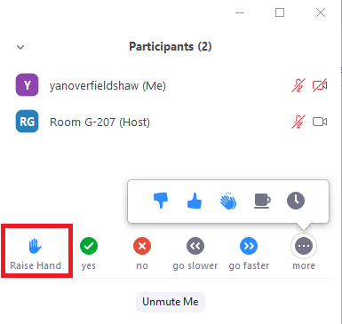
Electronic etiquette
Welcome – approx. 30 participants registered
Please mute yourself when not speaking.
There will be opportunities for discussion/comments/questions several times during the meeting. Please use the “Raise Hand” if you want to speak. Please “Raise Hand” again when you have spoken.
Press “Participants”
Press “Raise Hand” to speak
and after you have spoken

Slide 3
Agenda
Topic | Leader | Time (min)
Housekeeping | Bob Freed | 2
Introductions | Jose Ramirez | 5
Present project concept and review topic survey | Jose Ramirez | 15
Discussion | all | 25
Develop Path Forward | all | 5
365 – SMR Catalyst Tubes Strategies for Replacement Survey
Description of Meeting Topics:

Slide 4
General Background
SMR catalyst tubes are designed to operate within the creep range. The rate of creep damage is a function of material properties, load, and temperature.
The overall reliability of Ammonia, Methanol, and Hydrogen plants is directly linked to reliability of steam reformers (SMRs).
The cost of reformers is a substantial investment for the entire plant. In addition to downtime production losses, SMRs catalysis tube failures may result in significant safety risks, as well as replacement costs.
In order to maintain plant production and avoid unplanned shutdowns and production losses, a proper integrity management program for catalyst tubes is critical.

Slide 5
General Background (MTI Forum)
Supplier –to –supplier material creep behavior variation (compositional changes, aging behavior, creep ductility, etc.). Some supplier datasheets tend to be overly-optimistic.
Tube temperature variation (location in the furnace, flue gas flow, etc.). Uncertainty in temperature monitoring (end of row and at the bottom of the furnace).
The Omega method (testing) focuses on tertiary creep. Question applicability for catalysis tube materials, which may present a significant primary and secondary creep behavior. Modified Omega model can be applied to aged SMR tubes.
Continuum Damage Mechanics (CDM) models (microstructural aging, creep damage).
Replacement strategy based on temperature monitoring, baseline data, periodic crawler inspections, operating experience, and some decent CDM based material models.
The advantage of the real-time IR and Omega (or any method) modelling is that it allows you to plan for replacements well in advance of being able to perform the OD measurements during a shutdown.
Despite all these uncertainties, catalysis tubes, when operated within the design conditions, should last significantly longer than their design lives.
There are almost as many ways people have proposed for assessing tube remaining life as the number of SMRs out there.

Slide 6
SMR Cat Tubes: “Strategies / Practices for Replacement” Survey:
Overall Design of SMR. Top-fired, Side-fired, Bottom-fire
Main production from plant. Hydrogen, Methanol, Ammonia
Cat Tube Materials. HP, HP-modified, HP-Micro-alloyed, Others
Cat tube design practices. API 530 general practice, Use of safety factors, Consideration of thermal stresses (normal production variation, trips, shutdowns, effect of tube thickness, etc.), service life, etc.
Temperature monitoring program, methods, and techniques
Inspection Techniques and Criteria for replacement. Cracking, OD measured growth, ID measured growth, etc.
Creep Testing Techniques and damage models. Omega , creep rupture, etc.
Overall Strategy for Replacement. Based on fixed service life (100k, 150K, 200K hours; etc.); Sequential replacement of tube population to be completed in a given span of years; Based on control of number of tube vintages in the reformers; Based on estimated remaining life (LMP); Based on creep test data (Omega or rupture); Based on cat tube inspection results; based on CDM models; based on combination of listed approaches or any additional considerations, etc.
…………

Slide 7
Thank you / Tell me more
June Meeting Invitation
Questions, comments
Survey is of value?
Willingness to participate to design survey
Willingness to participate and share company practices
October Update
Reiterate June invitation
Survey is of value ? (hydrogen economy, practices exchange, potential development of standard practices)
List / grouping of potential factor / practices to include in the survey

