Slide 1
MTI Project 357: High-Temp Fatty Acid Corrosion in Bio Oils API Roundtable on Biofuels May 16, 2022
MTI Project Co-champions:
Nate Sutton, E²G Maricela Johnson, Chevron

Slide 2
MTI Project 357 – Corrosion in Bio Oils
Introduction and background
Fatty acid corrosion is a big “unknown” in RDU projects/conversions
Getting to be less unknown
Concern at high temperatures in the reaction loop
Potential concern for “warm” (>300F) handling in carbon steel.
Project 357 includes:
Literature search - 180 papers and 91 patents were deemed potentially relevant.
48 papers were obtained by MTI in the last few months; patents will follow
Volunteer team is reading/interpreting/distilling the data available
So far, no treasure trove of data has been found – as expected.
Validates need for physical testing.
Most papers address catalysts, reactions, process technology for hydrotreating.
Other papers are biodiesel (transesterification), not hydrotreating

Slide 3
MTI Project 357 – Corrosion in Bio Oils
Experimental Program Update
Two stages of the project have been funded so far
Stage “0” – High Temperature Degradation of Distillers’ Corn Oil (DCO – test media)
Funded by MTI November 2021 for $90,000
5 tests completed to date, about 80% complete; 1-2 additional tests to be performed
Objective: observe the changes in test medium at the intended corrosion test conditions
550-750F, 1500 psi nitrogen or hydrogen, for 48 to 96 hours
Stage 1 – High Temperature Corrosion testing under flow (rotating cage) conditions
Funded by MTI March 2022 for $135,000
Tests to start June 2022 after completion of stage “0”

Slide 4
MTI Project 357 – Corrosion in Bio Oils
Project Steering
Full Project team (64 individuals) meets at MTI AmeriTAC meetings (every 3 months) and occasionally between
For short-term decision making, a small steering team with about 12 people has formed:
Nathaniel G. Sutton, E2G
Andy Gysbers, Becht
Robert Freed, MTI
Kyle Hilgefort, DNV
Sridhar Srinivasan, Becht
Peter Hillman, Chevron
Brandon Rollins, DNV
Lokesh K. Choudhary, Phillips 66
Maricela Johnson, Chevron
Ivan Morales, ExxonMobil
Garry Jacobs, Fluor
Mark van den Broek, Fluor
Anette Hansson, Haldor Topsoe
David Bierschenk, Phillips 66

Slide 5
MTI Project 357 – Corrosion in Bio Oils
Preliminary Oil Degradation Test Results
Tests completed to-date:
750F, 1500 psi H₂ (48 hours)
750F, 1500 psi N₂ (48 hours)
650F, 1500 psi H₂ (48 hours)
550F, 1500 psi N₂ (96 hours)
550F, 1500 psi H₂ (96 hours)
Samples of the oil area extracted at a decreasing frequency during the test
Approximate times of 0, 1, 2, 3, 4, 5, 8, 12, 16, 24, 32, 48, 72, 96 hours
Changes (degradation) are most rapid during heating and in the first 1-2 hours
At 750F, Oil Degradation was too rapid to support a target 48 or 96-hour corrosion test.
Nitrogen vs Hydrogen does not appear to have an effect on degradation
At 650F, TAN increases quickly and then steadies and maintains a plateau
Sufficient to support a 48-hour corrosion test.
At 550F, Oil Degradation was too slow to support a target 48 or 96-hour corrosion test.
Hydrogen reduces gumming/polymerization; Currently analyzing TAN to understand H₂ effect on acid

Slide 6
MTI Project 357 – Corrosion in Bio Oils
Oil Degradation Test Sample Analysis:
TAN – Total Acid Number
ASTM D664 (AOCS Ca-5a-40 is roughly the same titration procedure)
“Glycerides” test
Free and Total Glycerin, Monoglycerides, Diglycerides, & Triglycerides
ASTM D6584
Intends to see degradation/cracking of the triglycerides
In theory, free fatty acids + mono-, di-, and tri-glycerides and glycerin should equal about 100% (moisture, cracking products reduce this)
Iodine Value test for double bonds (AOCS Cd 1d-92)
Team theorized that IV could provide a corollary for oil degradation, since FFA/TAN would be “consumed” by the corrosion reaction (iron carboxylate salts)
This does not appear to be the case (IV decreases regardless of FFA increase/decrease)

Slide 7
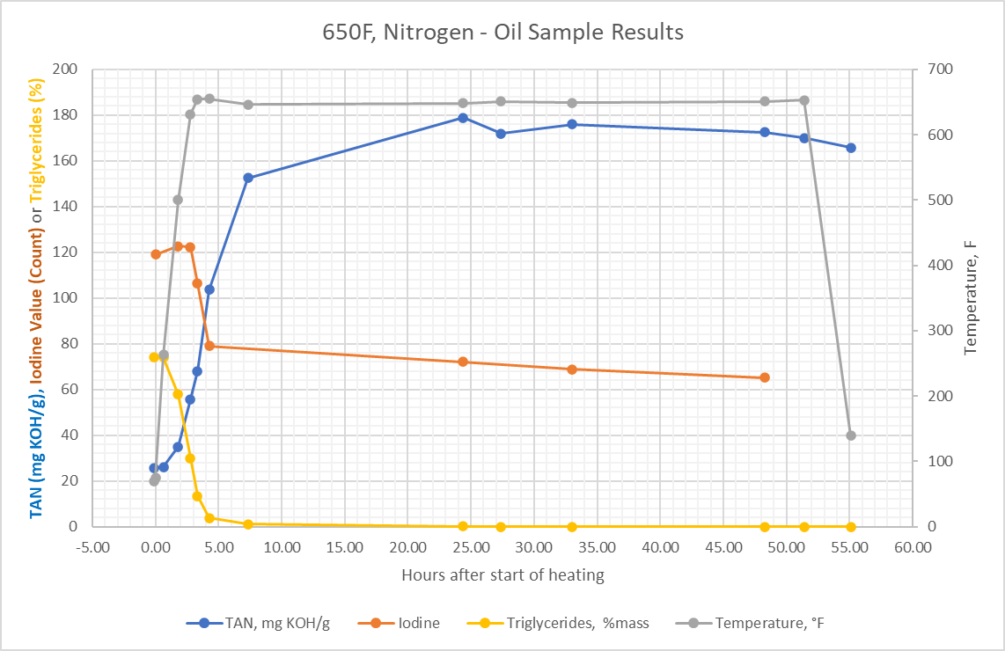
MTI Project 357 – Corrosion in Bio Oils
Triglycerides are quickly converted to free fatty acids (FFA)
Unlike 750F exposures, FFA do not quickly degrade/crack
650F 170-780 TAN would be a “worst case” test
Much higher TAN than typical hydrotreater feed circuits
Dilution with inert oil may facilitate 650F testing at lower TANs

Slide 8
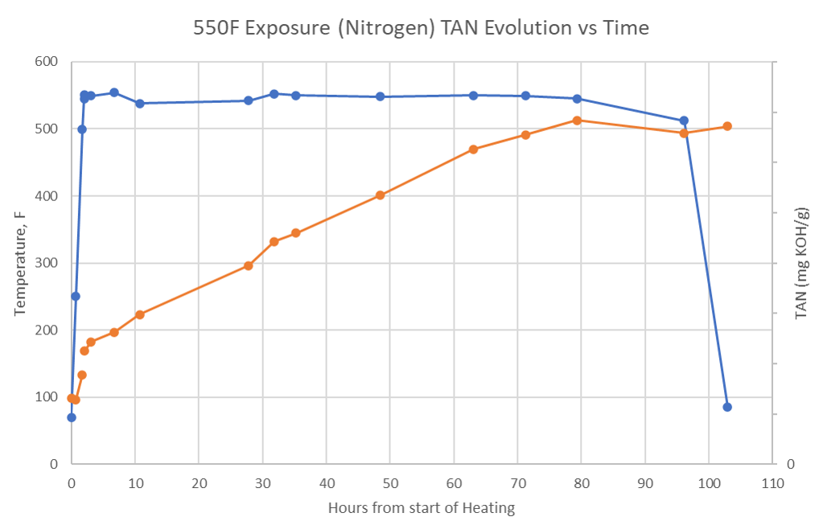
MTI Project 357 – Corrosion in Bio Oils
Peak TAN at 550F is lower (plateau at about 135 vs 175 at 650F)
However, the oil takes too long to reach this peak, complicating the corrosion test.
For information, we placed 2 carbon steel coupons in this test:
Average corrosion rate >1300 MPY

Slide 9
MTI Project 357 – Corrosion in Bio Oils
Project outlook & next activities:
Stage “0” degradation testing will wrap up in the next few weeks
Stage 1 corrosion tests being deliberated by the steering team and project team
650F, 170-180 TAN, Nitrogen and Hydrogen (2)
650F, diluted to 50-60 TAN and 100-110 TAN (max), Nitrogen and Hydrogen (4)
550F, “trickle-through” testing to keep TAN consistent.
Replenishment rate of 25 TAN DCO based on degradation rate (temperature) and target TAN in the test.
MTI Project team will make a decision on which alloys to test. Alloys on-hand include:
Carbon Steel
2.25Cr-1Mo
9Cr-1Mo
304 SS
316 SS
317L SS
2205 DSS
2003 LDSS
625
825
904L
AL6XN
254SMO
5Cr
410 SS

Slide 10
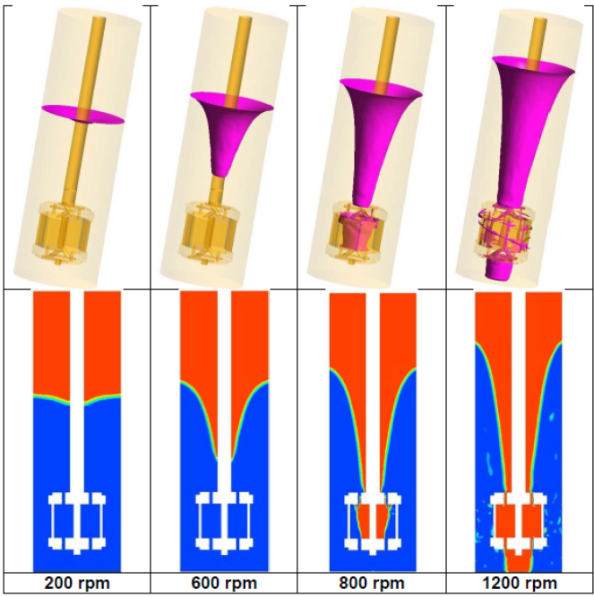
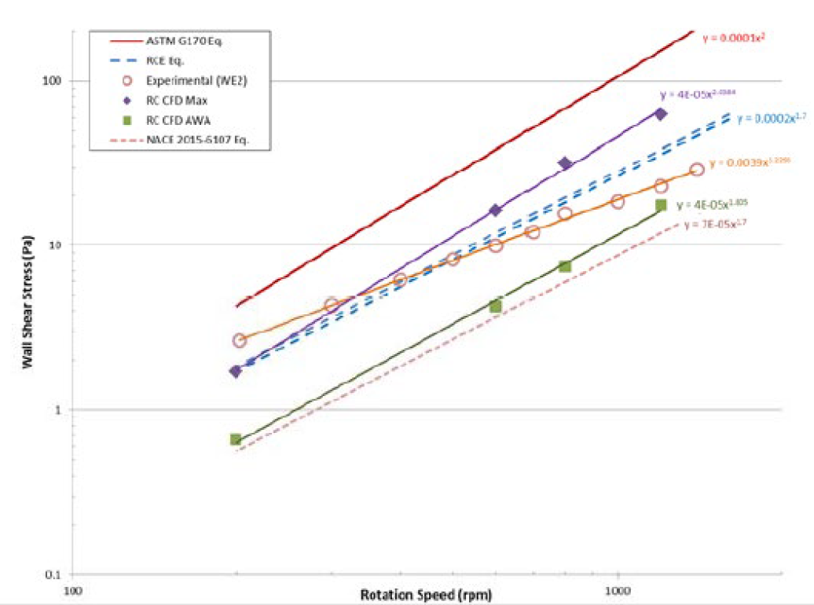
MTI Project 357 – Corrosion in Bio Oils
Rotating Cage Test Apparatus (Stage 1 tests)

Slide 11
MTI Project 357 – Corrosion in Bio Oils
Replenishing oil during test
Standby “feeder” autoclave with preheated DCO (250-350F)
Degraded oil removed from test autoclave by sampling
TAN to be checked post-test even during corrosion tests
25 mL volumes for each sample
In addition to sample volume, option for time-controlled purging is being explored (manual vs lab flow controller options)
Concern for degradation of the oil during warm stand-by:
E²G donating oil samples from a separate corrosion test program
200-375F corrosion tests performed by E²G for a client project to guide decision on storage tank materials/coatings
TAN measurement not needed for these tests, but oil offered to MTI to help understand potential for degradation during warm stand-by

Slide 12
MTI Project 357 – Corrosion in Bio Oils
Thank you for your time!
Questions?

Slide 13
Brief Primer on MTI
MTI – The Materials Technology Institute, formed in 1977
From the outset, part of MTI’s purpose was to pool member company resources to fund research projects that would be of shared benefit/interest
5 meetings per year: 3 AmeriTAC, 1 EuroTAC, 1 AsiaTAC
TAC = Technical Advisory Council
Projects are proposed by member companies and if support exists, a project champion volunteers (or multiple champions).
Hundreds of projects completed to date
A dozen or more projects may be in progress at a time

Slide 14
MTI Project 357 – Corrosion in Bio Oils
Outline
Brief into/background on MTI
Quick background on bio-oil feed and product differences & characteristics
Project Introduction - Motivation and background
Scope of the Literature Review – what was included
Results of the Literature Review and next steps
Overview of testing plan and long-term goals
Some specific considerations for high-temp corrosion testing in bio-oils
Wrap up & Questions

Slide 15
Biodiesel vs Renewable Diesel
US Dept. of Energy, Alternative Fuels Data Center
Renewable diesel is a “renewable hydrocarbon biofuel”
Produced through various processes (“pathways”) such as hydrotreating, gasification, pyrolysis, and other biochemical and thermochemical technologies.
Meets ASTM D975 specification for petroleum diesel.
Renewable hydrocarbon biofuels are chemically identical to their petroleum-based counterparts: gasoline, diesel, or jet fuel.
They meet the same ASTM fuel quality standards as petroleum fuels
Can be used in existing engines and infrastructure without blending limits
Biodiesel is a mono-alkyl ester produced via transesterification.
Meets ASTM D6751 and is approved for blending with petroleum diesel in certain amounts.
B5 (5% biodiesel) is the most common blend for existing engines.

Slide 16
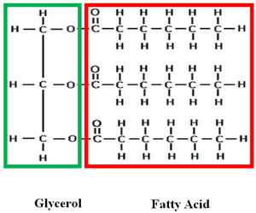
Bio-oils vs Bio-mass Oils
Bio-oil: typically refers to lipids from plants and animals
Includes vegetable oils, animal fats, greases, and algae-derived lipids
Contains a mix of triglycerides (incl. phospholipids) & free fatty acids (FFA)
A triglyceride has 3 FFA’s attached to a glycerol
In many vegetable and animal oils, the Fatty Acid has a similar length
(# of carbons) as a distillate-range hydrocarbon from petroleum (C12-C20)
Bio-oils serve as the feedstock for nearly all renewable and bio-diesel
Biomass-based oils: typically refers to cellulosic material
Includes crop residues/tillage, woody biomass, and dedicated energy crops
Biomass-based oils require different/additional pathways:
Biological (enzyme) sugar upgrading: Cellulose → glucose/sugars → hydrocarbon
Pyrolysis: high temperature decomposition, similar to thermal cracking
These pathways produce different corrosive species than lipid-based bio-oils
Lighter organic acids: formic, acetic, propionic etc.
The resulting oils also vary in boiling point (LPG range through distillate range)
Biomass oil technologies have not been widely adopted at this point.

Slide 17
MTI Project 357 – Corrosion in Bio Oils
Scope of the literature review:
Focus search on hydrodeoxygenation (HDO) processing of renewable fuels.
Corrosivity of bio-oils to common hydrotreater materials of construction (corrosion rates, corrosion mechanisms, compatibility) .
Applicability of total acid number (TAN) or free fatty acid (FFA) for predicting corrosivity.
Other indexes (like TAN) that can indicate the corrosivity of bio-oils.
Information on the role of hydrogen content in bio-oils HDO impact on corrosivity.
Patents (materials of construction or processes) to minimize bio-oil corrosion
Existing laboratory testing programs on bio-oil corrosion
Corrosion potential of bio oils with dissolved traces of water
Effect of elevated thermal cracking of different bio-oils
Corrosion inhibitor chemicals in bio-oils

Slide 18
MTI Project 357 – Corrosion in Bio Oils
Preliminary Results of the Literature Review
In total 180 papers and 91 patents were identified in the literature review.
A table of abstracts was compiled and reviewed by some members of the project
48 papers flagged as being worth a more thorough examination.
38 papers of interest that were considered most likely to contain corrosion data
10 papers of essential background information, such as biooil compositions, TAN, distillation curves, acid speciation, etc.
Remaining papers largely about chemical processes (reactions/catalysts/etc.) to reduce acidity of specific biooils to reduce their corrosivity.
These do not actually address degradation of the materials used in the chemical processes themselves
The next steps for the project team: Get access to the 48 papers and review in detail. Additionally, a review of the patents to determine which may be relevant

