Slide 1
Leveraging IOWs to Enhance Renewable Diesel Unit Reliability and Profitability
Nathaniel Sutton
E²G | The Equity Engineering Group Inc.
MTI Renewable Diesel Roundtable – June 21, 2022

Slide 2
Presentation Overview
Background Information for Integrity Operating Windows (IOWs)
Case Studies for IOWs to avoid…
Chloride SCC in 316L SS Distillers’ Corn Oil (DCO) acidic Pretreatment unit
Ammonium chloride (NH4Cl) Salting and Corrosion in a Coprocessing Hydrodeoxygenation (HDO) unit effluent system
Fatty Acid corrosion of Raw DCO storage tank(s), piping, and surge drum

Slide 3
Integrity Operating Windows (IOWs)
Integrity Operating Window (IOW) –
Established limits for process variables that – when violated for a period of time – can affect the integrity of the equipment
API RP 584 – 2nd Edition, 2021
Includes Standard, Critical, and Informational limits
Critical IOWs typically require an alarm
Some standard IOWs will have an alarm associated
Typically standard IOWs and some Informational IOWs will have an email alert or other non-alarm communication/notification associated
Informational IOWs may also be tracked and trended over time

Slide 4
Integrity Operating Windows (IOWs), cont.
Image referenced from API RP 584, 2nd Ed. 2021

Slide 5
Integrity Operating Windows (IOWs), cont.
A successful IOW program is a communication tool
IOWs ensure proper communication between key Process, Operations, and mechanical integrity (MI) personnel
The frequency and urgency of communication is based on the rate of degradation when an IOW limit is exceeded.
Critical IOW exceedance: alarm prompts an “immediate” reaction by operations, notifies process, MI personnel
Informational IOW exceedances may only be realized during a monthly or quarterly summary of process parameter
IOWs will not eliminate corrosion risk but aim to achieve predictable and reasonably low rates of asset degradation.

Slide 6
Limitations of Process Data and IOWs
During the Damage Mechanism Review (DMR), part of establishing IOWs, sampling or monitoring insufficiencies may be revealed
Sampling or measurement rate should be based on process rate of change or damage (corrosion rate)
E.g., monitoring total ΔP across stacked exchangers may not reveal salting/fouling in time to avoid under deposit corrosion/cracking
Monitoring heat transfer by calculating and trending UA coefficient may be needed to trigger intermittent water wash
E.g., weekly sampling of cold separator water may not detect low-pH events from day-to-day feed changes (co-processing ratios)
IOW project may identify priority sample point areas/upgrades

Slide 7
Integrity Operating Windows (IOWs), cont.
Commonly assumed that IOWs will limit operation
However, IOWs may reveal opportunities to push operation, e.g.,
Pushing closer to a heater temperature limit
Allowing higher-contaminant feeds (for renewables, higher TAN, higher Chlorides)
IOWs can increase profitability while increasing reliability and MI confidence during flexible operations

Slide 8
IOW Example #1 Chloride SCC in 316L DCO Pretreatment Unit

Slide 9
IOW Ex #1 - ClSCC in 316L DCO Pretreat Unit
DCO and other raw renewable feeds contain impurities that affect filters, hydrotreating catalyst activity, and cause corrosion
Metals (Ca, Mg, Na, K, Fe, Al)
Silicon
Phosphorous (As phospholipids, a.k.a. “phosphatides”)
Chloride (organic/non-extractable and inorganic)
Cl comes from irrigation water, fertilizers, water used in processing (e.g. during wet extraction or mashing/saccharification for fuel ethanol)
Gums
Crude oil from oilseeds (dry-extracted) consists mainly of hydrated phosphatides, with some entrained oil and meal particles
Water-degumming or acid-degumming

Slide 10
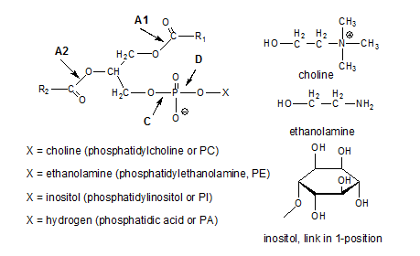
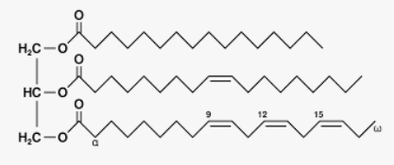
Normal triglyceride:
Phospholipid or Phosphatide:
Fatty Acid
Phosphate
X
For Everyone:
X = Hydrogen,
Amine, or sugar
glycerol
Fatty Acid
glycerol
Fatty Acid
Fatty Acid
Fatty Acid
For the Organic Chemists in the Room:

Slide 11
IOW Ex #1 - ClSCC in 316L DCO Pretreat Unit
More on Degumming:
Phosphorous removal depends on pH:
Nitrogen-containing (amine) phosphatides are more extractable at pH 2-4
Sugar-containing (inositol) phosphatides and hydrogen-phosphatides (phosphatidic acid) are more extractable at pH ≥ 4
Calcium salts of phosphatidic acid are essentially non-extractable
Main constituents of the nonhydratable phosphatides (NHPs)
Require alkali refining to remove
pH also reduces saponification (e.g., conversion of oleic acid into soluble sodium oleate)
Phosphorous causes catalyst poisoning and filter issues/fouling

Slide 12
IOW Ex #1 - ClSCC in 316L DCO Pretreat Unit
Warm, acidified (aqueous) high pressure, pretreatment is performed
Concern for Chloride SCC in aqueous phase
Strong economic incentive (material cost, schedule) to construct unit from type 316L stainless steel
Critical factors for ClSCC:
Chloride content (ppm)
Temperature (>140°F)
pH
Dissolved oxygen
Sensitization
Concentration mechanisms
Aqueous phase; DCO up to 10 ppm
Acid/Water degumming ≤ 470°F
Citric acid, pH 2.5-5.0
Incoming oil essentially saturated
Should not be an issue with L-grade
Gums/fouling, underdeposit

Slide 13
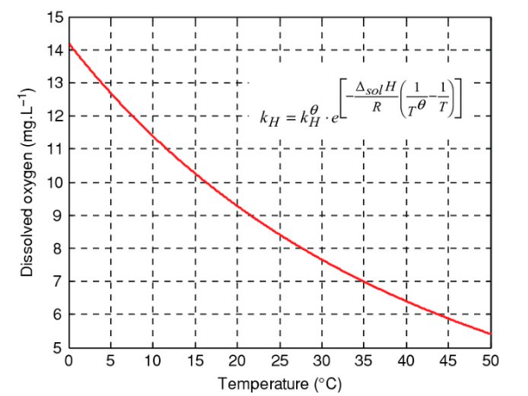
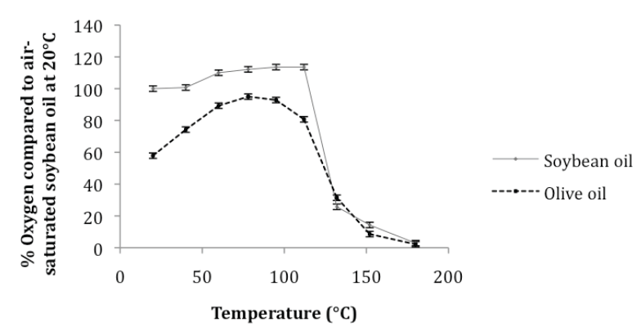
IOW Ex #1 - ClSCC in 316L DCO Pretreat Unit
Dissolved Oxygen:
Saturation is approx. 60 ppmw at storage temperatures
Oxygen has higher solubility in oil than in water
As mixture of vetetable oil and water is heated, water phase will become oxygen saturated
Vegetable oil O₂ solubility increases slightly from ambient up to 100-120°C
Above this, decreases markedly
Results in excess oxygen at pretreatment temperatures
In water
In Veg. Oil

Slide 14
IOW Ex #1 - ClSCC in 316L DCO Pretreat Unit
Chlorides in DCO feed:
Organic Chlorides - generally cannot be removed by pretreatment
However, in most vegetable oils, these are low (5 ppm or less in typical DCO, as reported on assays) and consistent, based on source
Waste cooking oil/used cooking oil (WCO/UCO) can have much higher organic chlorides, but no “representative” value can be selected.
Heat converts inorganic to organic chlorides
Inorganic Chlorides are much more easily removed by aqueous pretreatment
Carryover of water in the pretreated lipid is still possible.

Slide 15
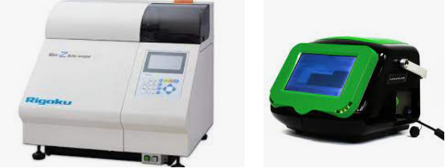
IOW Ex #1 - ClSCC in 316L DCO Pretreat Unit
Inorganic Chlorides:
Nearly all partition to the water phase
10-25% by mass flow rate (water vs oil)
10 ppm Cl⁻ in DCO concentrates to 100 ppm Cl⁻ in water for 10%; 40 ppm in water for 25% case
Assume concentration of Cl from water is minimal and controlled:
E.g. condensate or BFW water source
Measured and controlled chlorides in citric (or phosphoric acid).
Establish IOWs on oil feed - track via supplier assay & onsite analysis

Slide 16
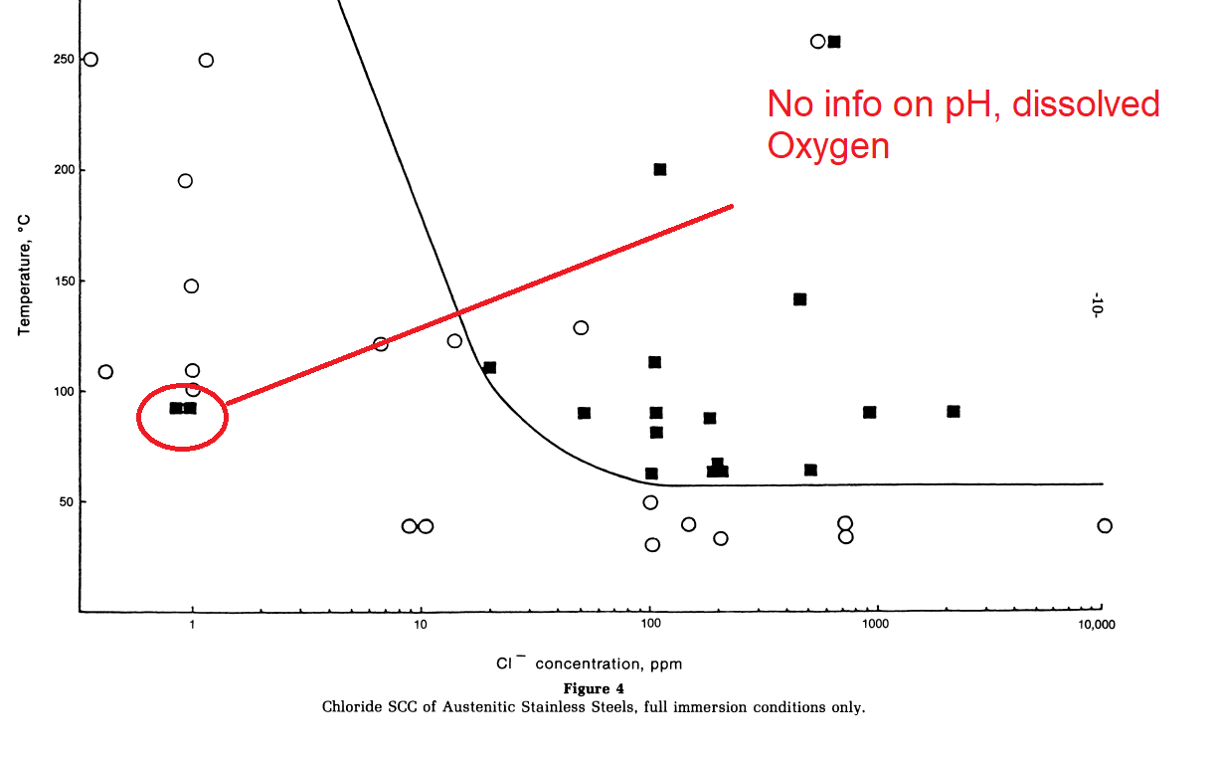
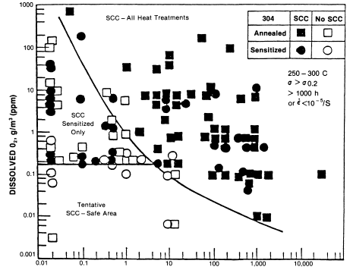
IOW Ex #1 - ClSCC in 316L DCO Pretreat Unit
Recommended limits to allow use of 316L:
Blended chlorides (total) in water phase – 1.0 ppm standard maximum
In oil feed = 0.10-0.25 ppm depending on oil-water ratios
pH target 5.0, minimum standard IOW 4.5, Critical 4.0
Throughput minimum as % of design (nameplate): mixing, fouling, deposit formation
Maximum limits on clarifiers/demulsifier (halide-containing)

Slide 17
IOW Example #2 Ammonium Chloride Salt Deposition and Corrosion in Hydrotreater Reactor Effluent Air Cooler (REAC) system

Slide 18
IOW Ex #2 – NH4Cl in Co-processing REAC Circuit
Co-processing unit running 0% - 20% Used cooking oil (UCO), soybean oil or pretreated corn oil with petroleum distillate
Soy/Corn maximum assumed 3 ppm Cl
UCO maximum assumed 50 ppm Cl
Petroleum distillate 100-200 ppm Nitrogen
(Nitrogen in renewable feeds and chlorides in petroleum feeds both negligible in this case).
Figure referenced from API RP 932B

Slide 19
IOW Ex #2 – NH4Cl in Co-processing REAC Circuit
Given: Variable Cl content with consistent excess nitrogen
Concern for “moving target” salt point
When not running renewables, salt points are low and effectively mitigated by normal continuous water wash (WW)
With renewable feeds, salt point temperatures are higher
Precipitate NH₄Cl further upstream; consider Intermittent WW
Complicating factor: water produced by hydrodeoxygenation:
1 mol triglyceride = 6 moles water
1 mol FFA or fatty acid ester = 2 moles water
3 mol fatty acid per triglyceride so effluent water depends on mass % renewable fed to unit

Slide 20
IOW Ex #2 – NH4Cl in Co-processing REAC Circuit
Conservative assumptions to help establish IOW limits:
All Cl fed to unit ends up as HCl in reactor effluent
Actually, some inorganic Cl may precipitate/foul
This is a problem of its own, but assuming 100% Cl → HCl maximizes salt point temperature
100% conversion of Nitrogen
Real conversion, depending on form (primary, ternary, etc.) could be 50-95%)
Assuming 100% R-N → NH₃ maximizes salt point temperature
100% of oxygen in renewable feed is converted to water vapor
Assuming 100% R-COOH → R-CH₃ + 2 H₂O maximizes relative humidity

Slide 21
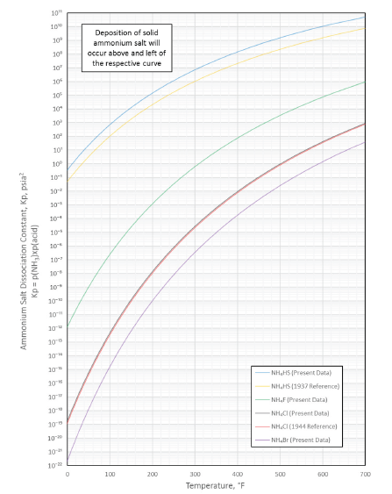
IOW Ex #2 – NH4Cl in Co-processing REAC Circuit
Salt point and relative humidity:
Limited guidance in 932B
Dry salts (below a certain %RH) are non-corrosive
Hydrated salts (above that %RH) are highly corrosive to carbon steels
Critical %RH for NH₄Cl to be corrosive is a function of temperature:
10% RH at 400°F and 20% RH at 176°F are both stated
In this case, 20% RH was applied up to 400°F
Increased risk of salting/corrosion for 20% vs 10% addressed through on-line inspections and separator water chloride IOWs.
Critical %RH for corrosive salts will differ
between SS HX tubes and CS piping
API RP 932B annex figure allows salt point Temp calculation (Figure not intended to be legible)

Slide 22
IOW Ex #2 – NH4Cl in Co-processing REAC Circuit
Two co-processing scenarios:
Low-chloride renewable feed
High %RH, relatively low salt point
NH₄Cl corrosion mitigation strategy – maintain stream above both salt point and water dew point (+25°F) until WW
Continuous water wash (WW) forces water dew point
High chloride renewable feed
High % RH and high salt point temperature
NH₄Cl corrosion mitigation strategy – maintain steam above the 20% RH temperature
But, allow bulk and/or local temperatures below the NH₄Cl salt point

Slide 23
IOW Ex #2 – NH4Cl in Co-processing REAC Circuit
20% RH curve: water mole fraction and effluent total pressure → water partial pressure
Saturation vapor pressure is a function of temperature
At saturation temperature (dew point) vapor pressure = partial pressure
20% RH, partial pressure = 20% of saturation vapor pressure

Slide 24
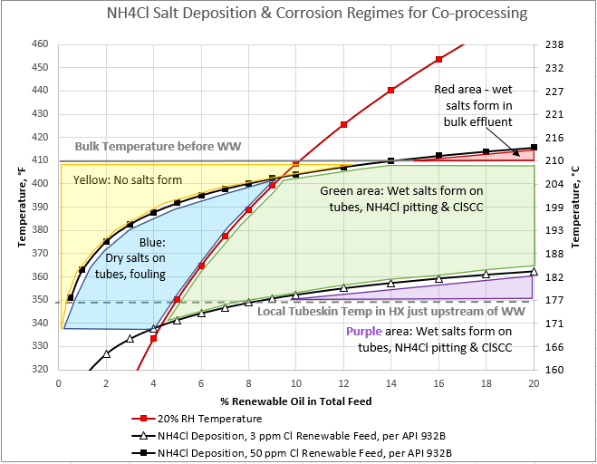
IOW Ex #2 – NH4Cl in Co-processing REAC Circuit
Bulk stream temperature
Local metal temperature within HX
High-Cl renewable salt point
Low-Cl renewable salt point

Slide 25
IOW Ex #2 – NH4Cl in Co-processing REAC Circuit
Two co-processing scenarios:
Low-chloride renewable feed: IOW limit on difference between stream and the higher of salt point or water dew point = 25°F minimum
High chloride renewable feed: IOW limit on difference between stream and the calculated 20% RH temperature = 25°F minimum
Both %RH temperature and Salt point temperature are calculated in real-time
IOW is a temperature delta against this calculated temperature
Smart IOW limit allows maximum renewable feed to be processed; maximize tax credit or RIN generation per gallon throughput.

Slide 26
IOW Example #3 Temperature limits for raw vegetable oil storage and preheated feed (carbon steel)

Slide 27
IOW Ex #3 – FFA Corrosion in Feed/Surge System
Incentive to minimize the portion of the tank being internally lined:
Floor and 2-3 feet of the shell much lower cost and time than 100% of wetted internals (shell, floating roof, vapor space, etc.)
Full coating about 3X capital cost and +10-12 weeks
Simultaneous incentive to increase storage temperature close to 200°F (minimize wax formation, extend feed filter life)
Concerns:
Free fatty acid (FFA) corrosion of bare portions of CS tank shell
Also affected material selection for steam coil
Durability of internal lining under floating roof (de-waxing scrapers)

Slide 28
IOW Ex #3 – FFA Corrosion in Feed/Surge System
No available data for specific vegetable oil being stored (DCO)
150-375°F temperature range of interest
(Considers shell and steam coil)
Expedited corrosion testing performed to predict corrosion rates in raw feed storage (immersion conditions)
Low corrosion rates at low predicted shell temperatures would justify bare CS (above anticipated water line)
High corrosion rates and high predicted steam coil temperatures would justify upgrade of coils to 316L
Alternative: lower steam pressure for heating coil to allow CS

Slide 29
IOW Ex #3 – FFA Corrosion in Feed/Surge System
Corrosion rates also used to establish temperature IOW limit for CS piping, feed preheating, surge drum
Long-term bulk storage – oil degradation limits maximum temperature before shell corrosion does.
Short-term preheat section – carbon steel corrosion rate limits maximum temperature (IOW established)
Expedited test program did not address flow-effects
For carbon steel piping, conservative velocity limits were applied
With online inspection and tracked velocities (feed rate), informational IOW limits could be established

Slide 30
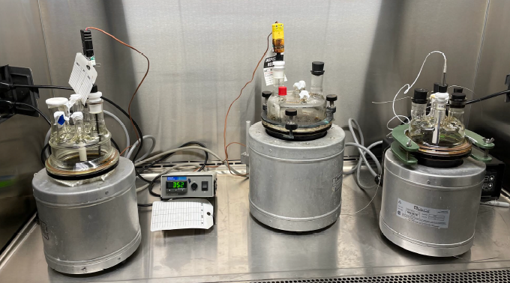
IOW Ex #3 – FFA Corrosion in Feed/Surge System
IOW set at a maximum 300°F standard
No impact to operation for this limit
For 300-350°F, required either:
Tank steam coil upgrade to 316L
Reduction in steam temperature (low pressure, 25# or 50# vs medium pressure, 150# steam) to continue using carbon steel coils
Note, this was upstream of a pretreatment unit; if RDU feed piping CS, iron contamination concern
CS and 316L Corrosion Rate vs Temp

Slide 31
Recap
IOWs may reveal opportunities to “push” operation
IOWs can increase profitability while increasing reliability and confidence of MI personnel
Examples of IOWs relevant to RDUs include:
Chloride and pH limits for aqueous pretreatment process(es)
Temperature limits for Co-processing REAC systems – NH₄Cl corrosion
Temperature limits for raw feed storage – FFA corrosion

Slide 32
Thank you for your time and attention!
Questions?
Nathaniel G. Sutton P.E.
Senior Engineer I, Group Head
E²G | The Equity Engineering Group, Inc.
P: +1.216.658.2233 M: +1.216.316.9833
E: nsutton@e2g.com

