Slide 1
MICROBIOLOGICAL CORROSION OF LEAN, SUPER, HYPER DUPLEX AND AUSTENITIC SS (301)
Project Champion: Karen Picker & Rodrigo Signorelli
March 1st, 2022
AmeriTAC 17
Orlando, FL

Slide 2
Meeting Agenda
Project Team Meeting (301) – Teams Meeting – June, 2020 MIC - Agenda
Topic | Leader | Time (min)
Introductions | Karen Picker | 5
Participants willing to run test | Karen Picker | 15
Next Step | Karen & Rodrigo | 10
SPS Review | Karen & Rodrigo | 20
Adjournment | Karen Picker | 5

Slide 3
Participants Running Test
Nova Chem - George Donald
Eastman - Huddle, Curtis
Advansix - Tiffany New-Courtney
Next Steps:
Order one rack to figure out stagnant conditions design
Select metallurgy via survey
Gather post test microbial analysis proposals
SES
University of Oklahoma - Dr. Bradley Stevenson

Slide 4
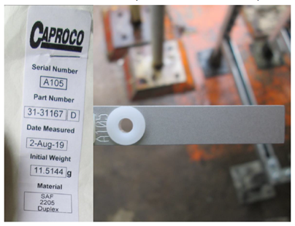
Coupons to be included in Survey
Which alloys to test?
316
2101
2205
2507
2707
6XN
Seacure
F255
CuNi
Ti
254SMO
Need UNS numbers listed
Other Metallurgies…
304 Stainless

Slide 5
SPS
Review of project objective from SPS:
“Define behavior parameters such as visual appearance of corrosion (pitting), microstructural changes (grain attack) and rate of progression of various stainless steels in MIC containing environments.”

