Slide 1
The use of polymeric coatings in storage and handling (before processing) as well as pretreatment:
Problematic areas where non-metallics may be a solution
Current coatings used in biofuels Railcars, Storage tanks and Process vessels

Slide 2
Presenters
Bob.Bernard@akzonobel.com, CSI, CDT
Engineering Solutions Representative
NACE, Level 2 Coating Inspector
Surojit.B.Mukherjee@akzonobel.com
Technical Specialist Manager
NACE, Level 2 Coating Inspector

Slide 3
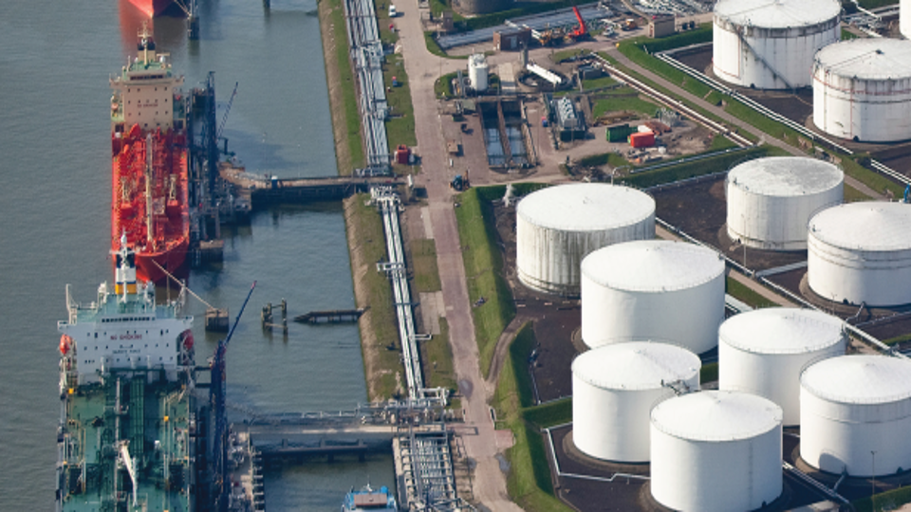
Key Facts
Protecting carbon steel tanks from biofuels-based feedstocks is not new – Marine cargo tanks.
Track Records in onshore Renewable Fuels Market since 2017.
Testing has shown some significant data that we are slicing and dicing to better understand these dynamic feedstocks.

Slide 4
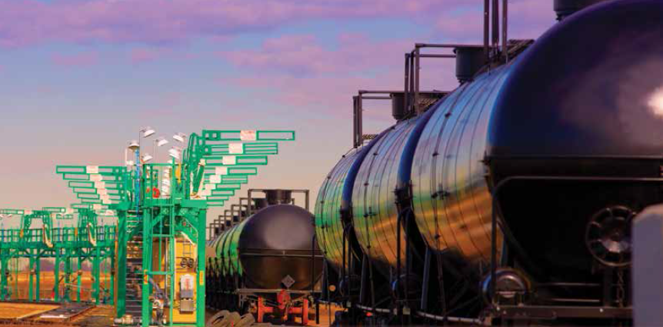
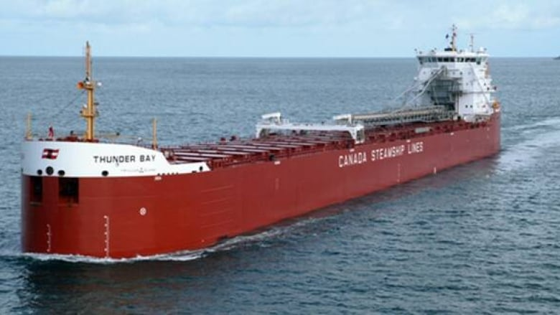
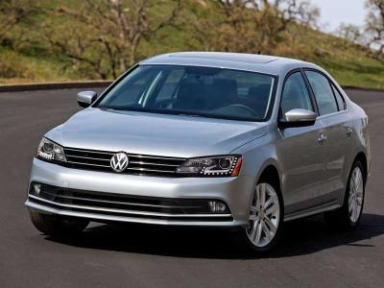
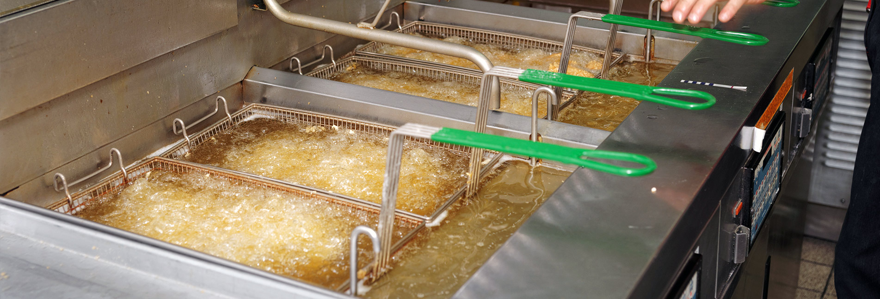
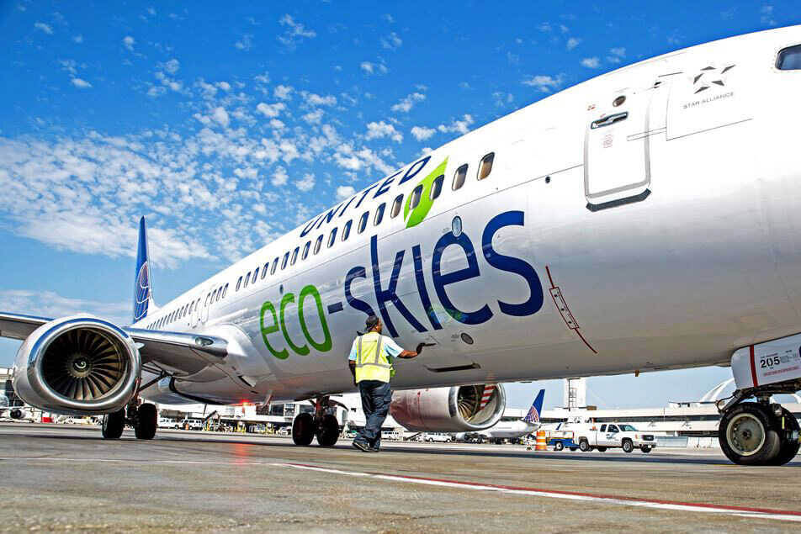
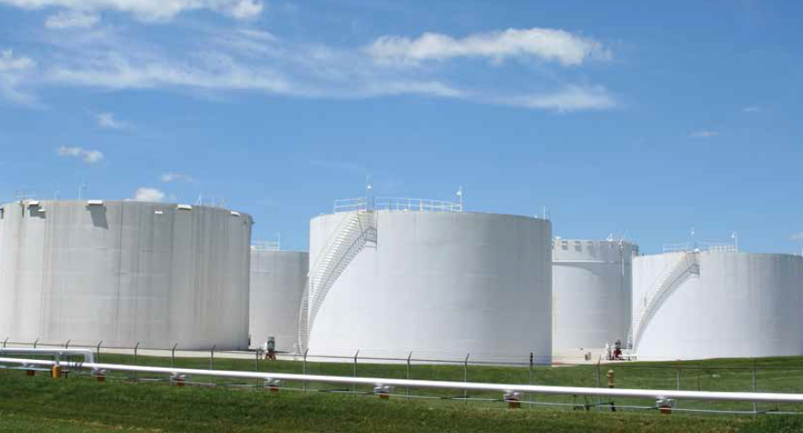
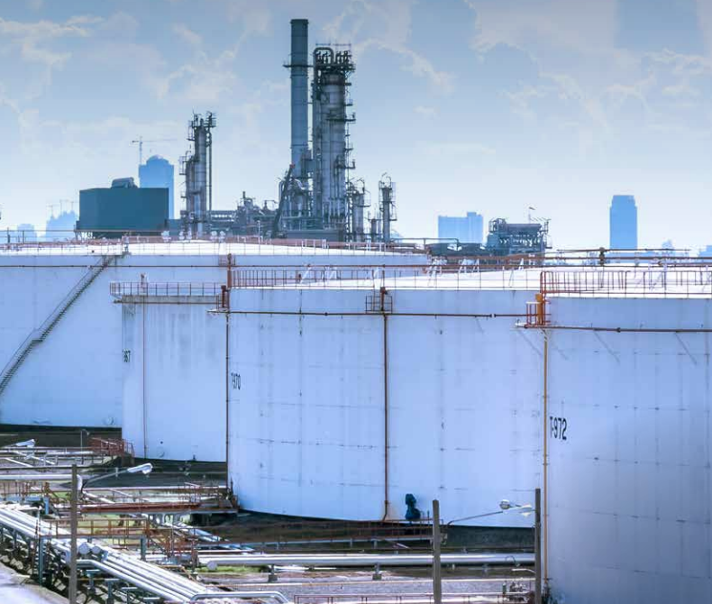
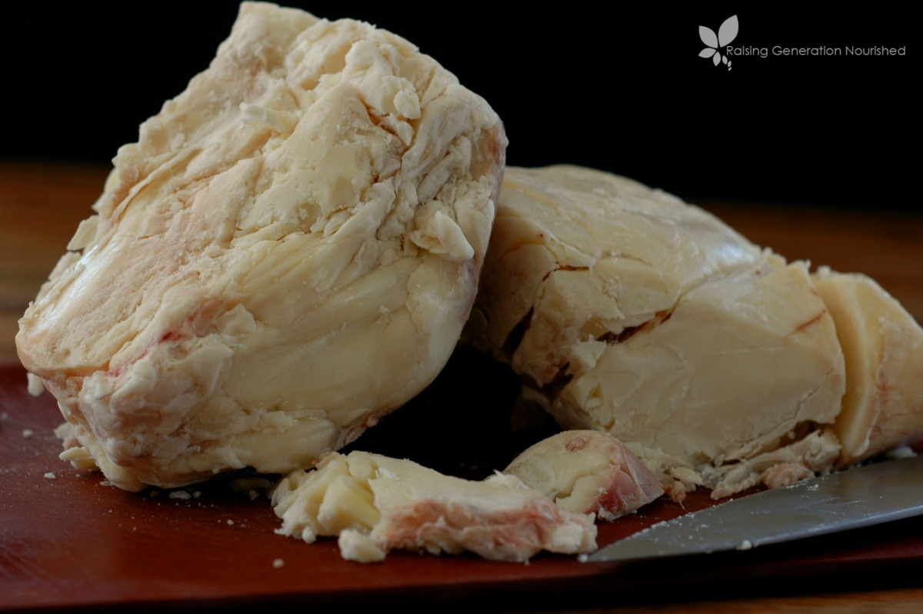
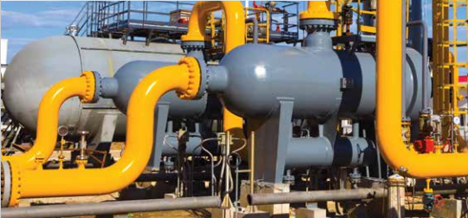
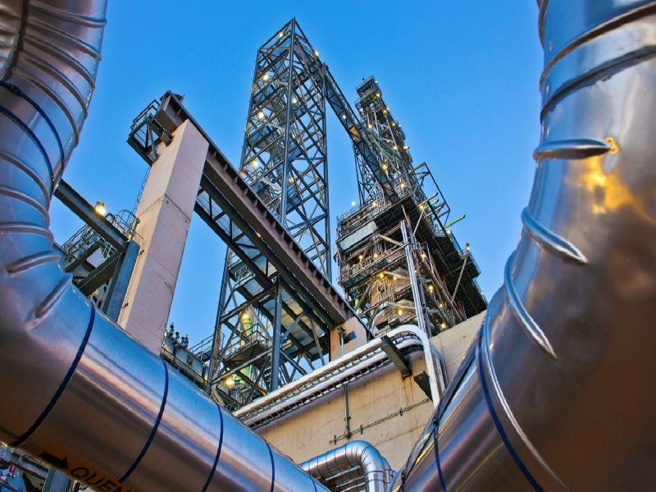
Follow the Feedstock

Slide 5
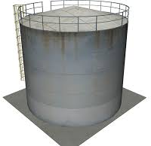
Follow the Feedstock
Storage tanks need to be broken down into categories, with each requiring their own Lining considerations:
Raw Feed
Need lots of info; dialogue with owners, EPCs, technology providers is key
Clean Feed
Less aggressive cargo if raw feed is cleaned well to maintain purity
Auxiliary
Range of tanks from slop, treatment, chemicals, process water, etc.
Finished Product
Properties similar to crude-based diesel / jet fuels
Cargo is less aggressive as it moves through the process

Slide 6
What has changed?
Broad range of feedstocks and products with differing compositions and broad range of storage temperatures (ambient up to 194°F)
Bioethanol
Impurities
Water content
Biofuels (+ Feedstock)
Free Fatty Acid (type and content)
Water content
More organic material
Varied composition
More susceptible to biological attack/decomposition (7-8 times vs. crude)

Slide 7
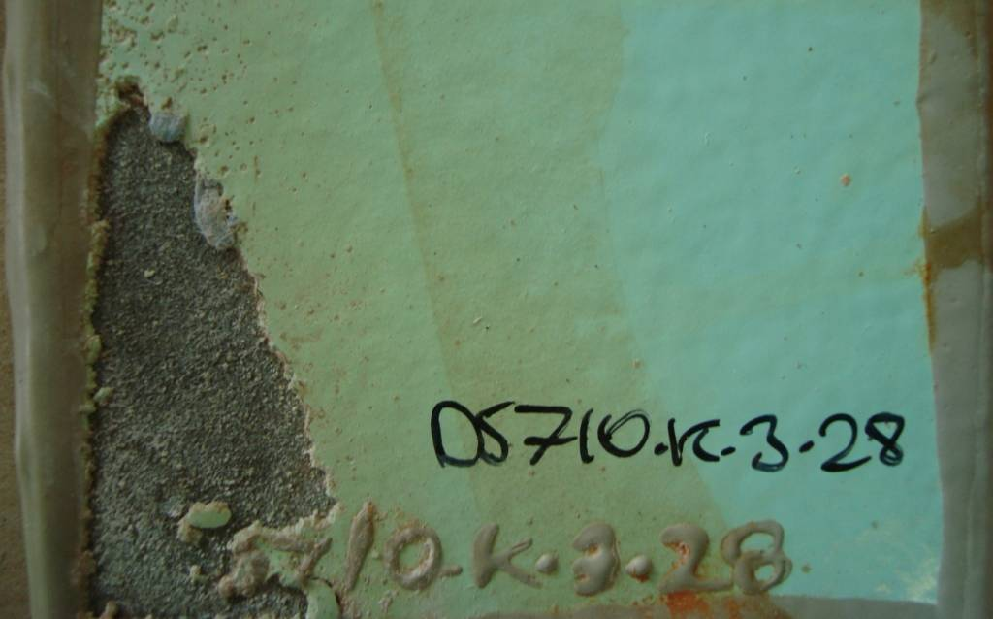
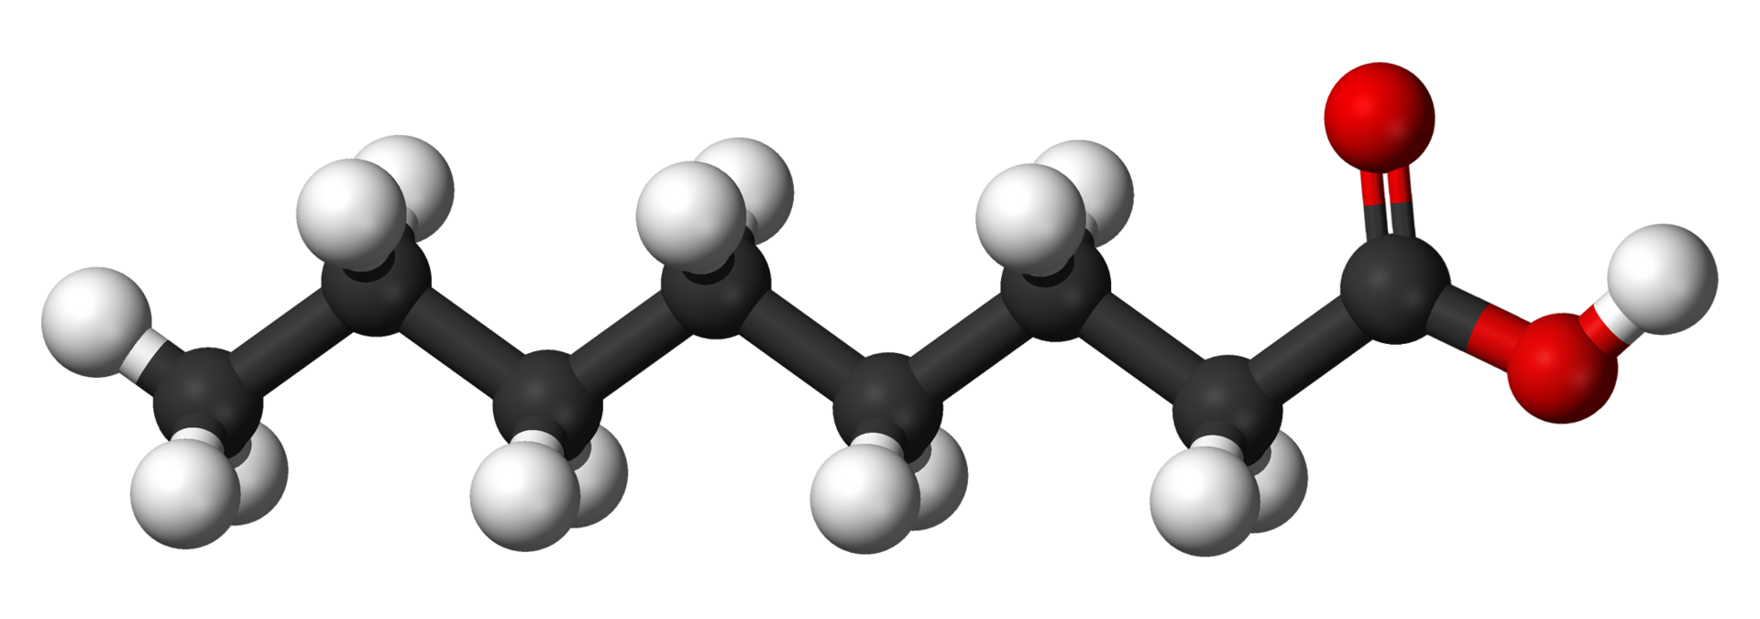
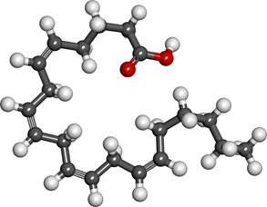
Biofuels (+ Feedstock)
Broader range of feedstocks with differing compositions
Free Fatty Acid (type and content)
C₈ more aggressive than C₂₀
Water content (%)
Mineral acid
Temperature (Loading/Offloading, Storage, Upsets)

Slide 8
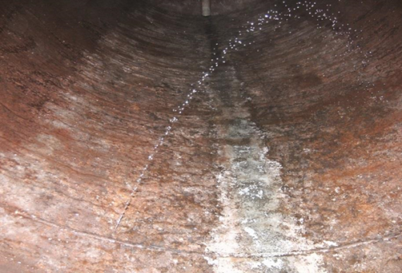
Biofuels (+ Feedstock) Corrosion Risk
Biofuels potentially corrosive to steel
Concerns regarding engineered alloys
MIC reported with Biofuels storage
Water content key to corrosion
Corrosion byproducts could contaminate or consume catalyst in the RDU
Key areas for tank lining discussion:
Bottom
Internal Shell
Underside Roof & Rafters

Slide 9
Functional Specification
What is to be stored?
Chemical composition
Temperature
Duration
Purity requirements
Approvals
What is the substrate and condition?
Carbon steel – new or pitted
Stainless steel
Concrete
What is the lifetime expectancy?
What are the application conditions?
What are the guarantee conditions?

Slide 10
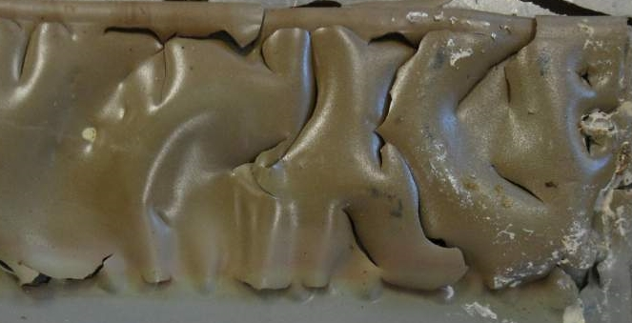
Generic Specification
Solvent Free Epoxy @ 1 x 20 mils dry film thickness
10% Free Fatty Acid
104°F
2% water

Slide 11
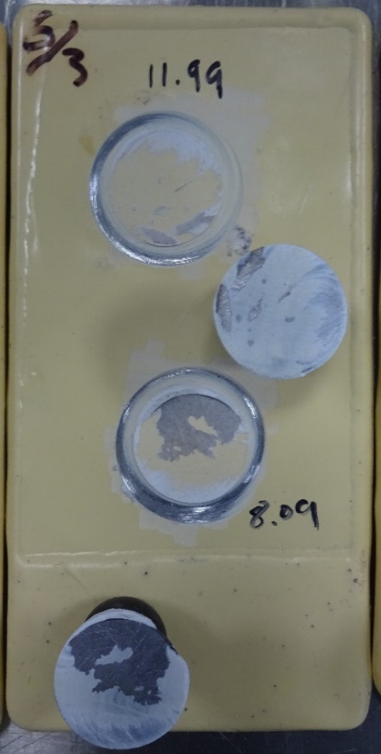
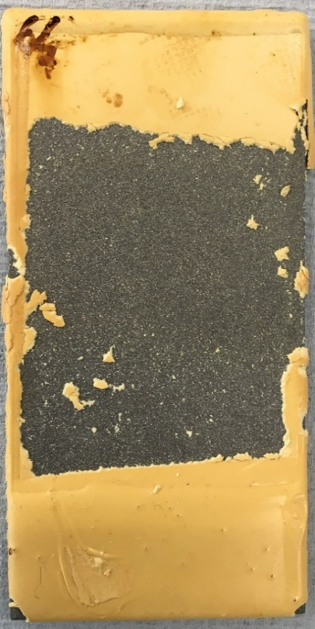
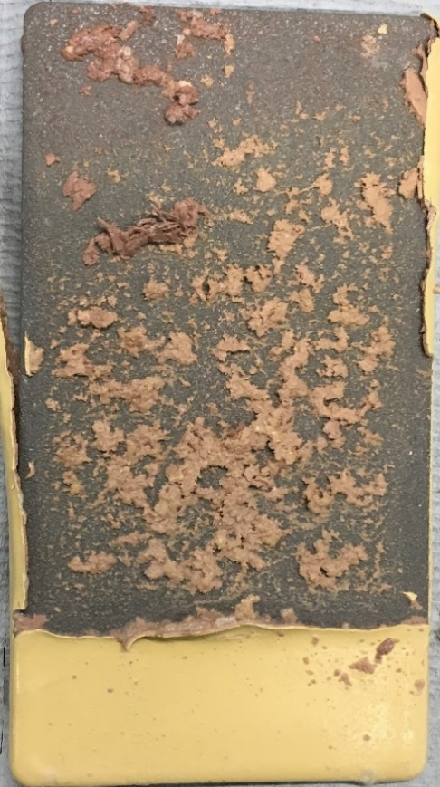
Free Fatty Acids (FFA)
Solvent Based Epoxy at 140°F
10%
50%
100%
Increasing Free Fatty Acid %

Slide 12
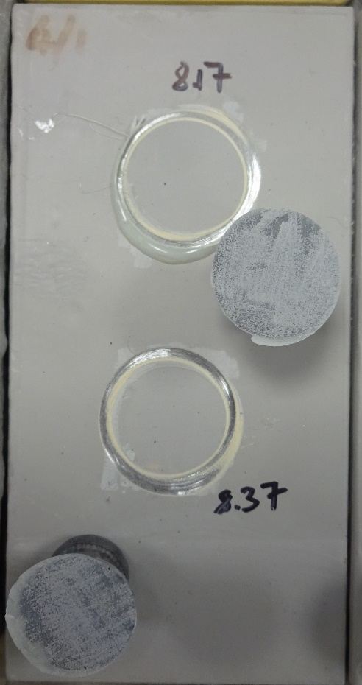
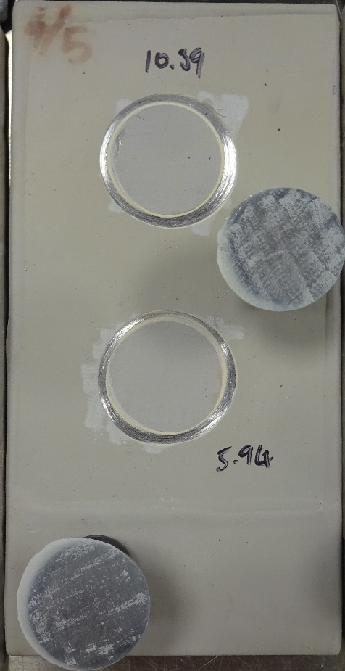
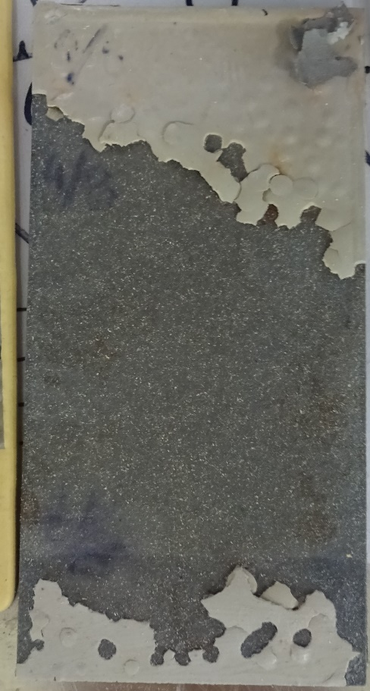
Free Fatty Acids (FFA)
Solvent Based Epoxy Phenolic with 100% FFA
140°F
158°F
176°F
Increasing Temperature

Slide 13
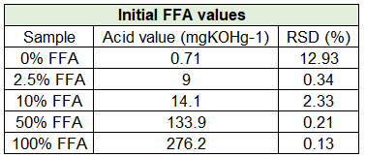
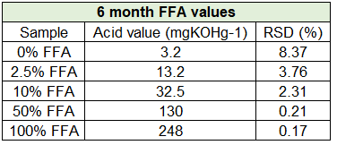
Rancidity
Rancidification is the process of complete or incomplete oxidation or hydrolysis of fats and oils when exposed to air, light, or moisture or by bacterial action, resulting in unpleasant taste and odor.
Hydrolytic (with water)
Oxidative (with oxygen)
Oxidative rancidity – oxidation of fatty acid fragments to form aldehydes and ketones
Vegetable oils are mostly Triglycerides . Triglycerides break down increase Fatty Acid content (Water/Temperature/Time)

Slide 14
Biofuels (+ Feedstock)
Biofuels/FFA and water are not compatible
Over time water layer can accumulate
At higher temperatures can be an issue

Slide 15
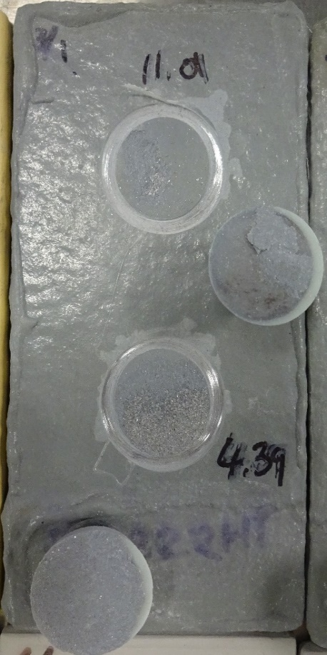
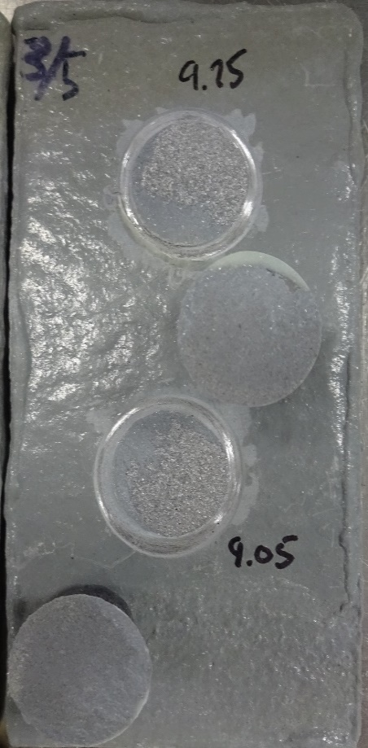
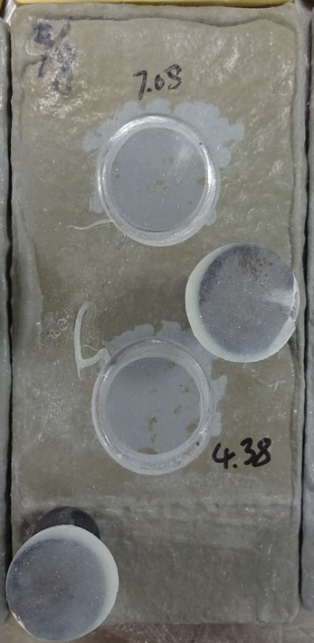
Free Fatty Acids (FFA)
Novolac Vinyl Ester at 178°F
10%
50%
100%
Increasing Free Fatty Acid %

Slide 16
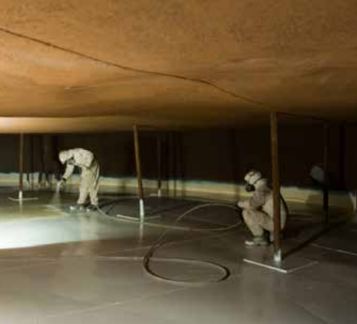
Technical Specification Summary
Ideal Systems
Novolac Vinyl Ester systems @ 1 or 2 coats
Novolac Polycyclamine Cured systems @ 1 coat
Novolac Epoxy Thin Film systems @ 2 coats
Vinyl Ester systems @ 1 or 2 coats
Notes:
282HB, 282, 232 405HTR
994, 253
242, 242HB

Slide 17
Best Practices
Important questions to ask:
Commodity?
Chemistry (FFA %, TAN, SDS, Acids, etc.)
Temperature (Loading/Offloading, Storage, Upsets)
Heating Elements (Coils or Panels, Location)
Water Content (%)
Cargo Purity (Catalyst consumption)
Tank type?
Fixed roof, Floating roof, Open top, Metallurgy
Application equipment?
Plural component or Single-leg
Budget?
Durability, Performance expectations
Keys to success:
Communication
Owner
Technology Provider
EPC
Coating/Lining Vendor
Applicator
Plan for future feedstock changes
Dedicated tank
Mixed tank
Availability

Slide 18
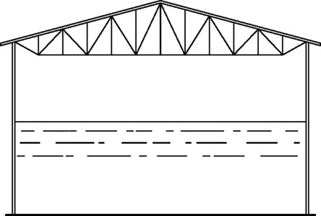
Tank Lining Scenarios
Line nothing
Stainless steel tank, non-corrosive cargo(s), or dedicated cargo(s)
Line bottom and up shell ~ 3 feet
Carbon steel crude tanks
Line bottom and up shell ~ 3 feet + roof & rafters and down X feet
No corrosion anticipated in middle and/or floating roof
Line bottom and full shell
Carbon steel bottoms/shell
Stainless steel roof & rafters
Line entire tank
Carbon steel tanks with expected corrosive atmospheres
Proactive approach to future feedstock needs

Slide 19
Tank Lining Scenarios
Line nothing
Stainless steel tank, non-corrosive cargo(s), or dedicated cargo(s)
Line bottom and up shell ~ 3 feet
Carbon steel crude tanks
Line bottom and up shell ~ 3 feet + roof & rafters and down X feet
No corrosion anticipated in middle and/or floating roof
Line bottom and full shell
Carbon steel bottoms + shell
Stainless steel roof & rafters
Line entire tank
Carbon steel tanks with expected corrosive atmospheres
Proactive approach to future feedstock needs

Slide 20
Tank Lining Scenarios
Line nothing
Stainless steel tank, non-corrosive cargo(s), or dedicated cargo(s)
Line bottom and up shell ~ 3 feet
Carbon steel crude tanks
Line bottom and up shell ~ 3 feet + roof & rafters and down X feet
No corrosion anticipated in middle and/or floating roof
Line bottom and full shell
Carbon steel bottoms + shell
Stainless steel roof & rafters
Line entire tank
Carbon steel tanks with expected corrosive atmospheres
Proactive approach to future feedstock needs

Slide 21
Tank Lining Scenarios
Line nothing
Stainless steel tank, non-corrosive cargo(s), or dedicated cargo(s)
Line bottom and up shell ~ 3 feet
Carbon steel crude tanks
Line bottom and up shell ~ 3 feet + roof & rafters and down X feet
No corrosion anticipated in middle and/or floating roof
Line bottom and full shell
Carbon steel bottoms + shell
Stainless steel roof & rafters
Line entire tank
Carbon steel tanks with expected corrosive atmospheres
Proactive approach to future feedstock needs

Slide 22
Tank Lining Scenarios
Line nothing
Stainless steel tank, non-corrosive cargo(s), or dedicated cargo(s)
Line bottom and up shell ~ 3 feet
Carbon steel crude tanks
Line bottom and up shell ~ 3 feet + roof & rafters and down X feet
No corrosion anticipated in middle and/or floating roof
Line bottom and full shell
Carbon steel bottoms + shell
Stainless steel roof & rafters
Line entire tank
Carbon steel tanks with expected corrosive atmospheres
Proactive approach to future feedstock needs

Slide 23
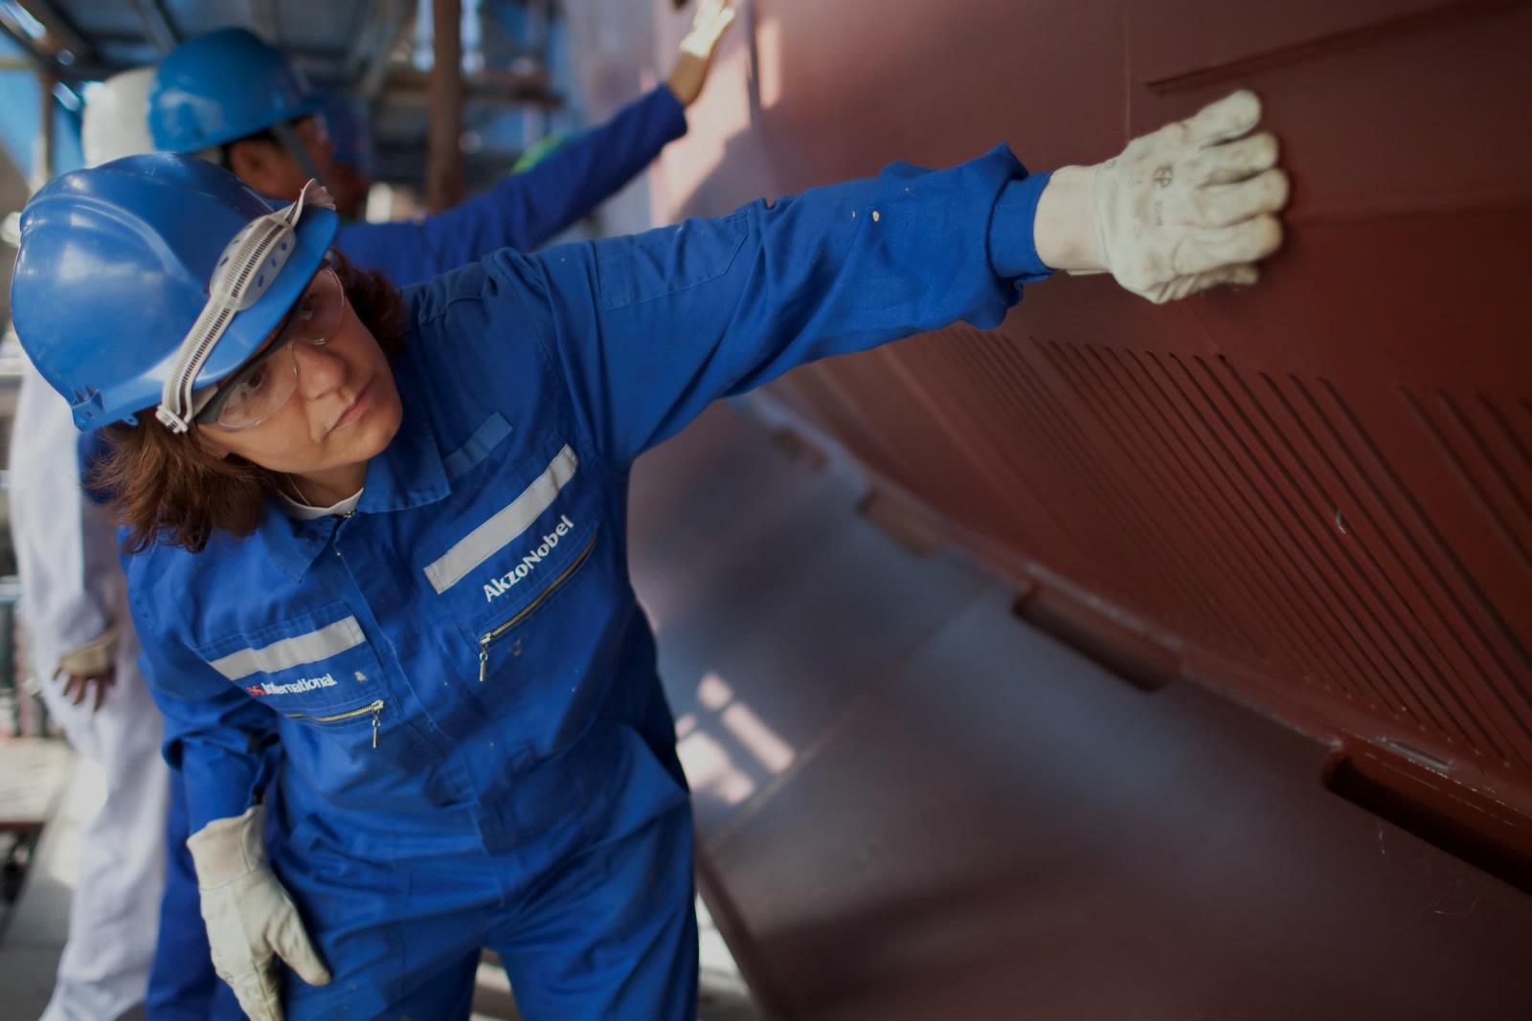
Lessons Learned
First Renewable Diesel Project (2017)
Fatty acid (tallow) tank
Issues were noticed with the tank metallurgy and lining after only 6-months in service
Lining was applied on floor and up the wall 8 feet
Suspected challenges with lining installation (and possibly surface preparation), but not confirmed
Corrosion of shell and vapor phase (mainly) was key reason for tank coming out of service
New shell courses and entire top of tank replaced
Entire tank was relined with different lining that was more user-friendly (2-component)
Opened for inspection in 2021 and looked like day it was re-installed
Owner currently uses this tried-and-trusted system for all fatty acid (tallow) tanks
Latest Sustainable Aviation Fuel Discussion (June 2022)
Recent information indicates processing temperatures could be higher to reduce usage of costly catalyst
Likely will impact the current metallurgy and/or linings used in the industry
Notes:
Surface prep and application issues

Slide 24
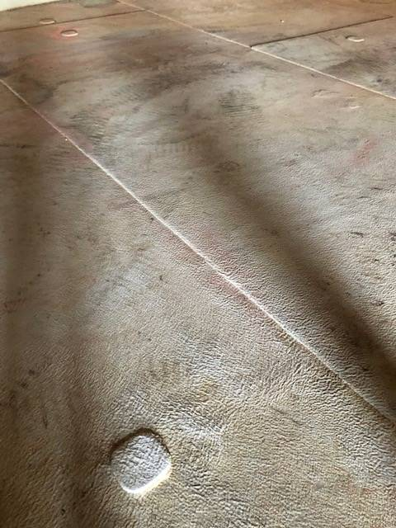
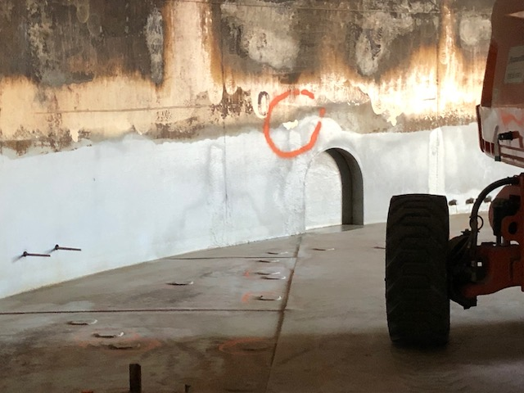
Lessons Learned 2017
Notes:
Surface prep and application issues

Slide 25
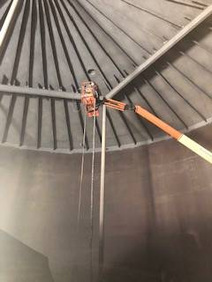
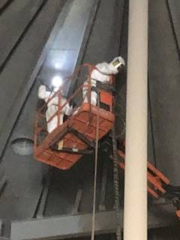
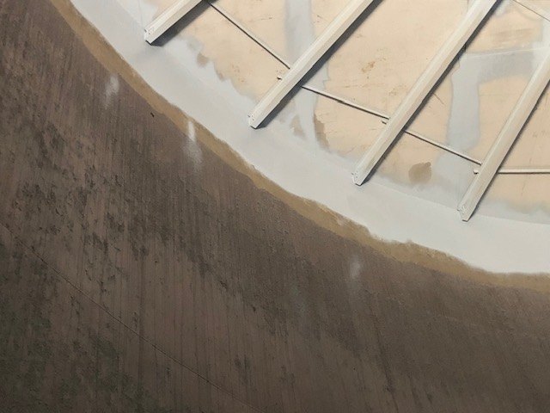
Lessons Learned 2018
Notes:
Surface prep and application issues

Slide 26
Key Takeaways
Infrastructure needs to be broken down into categories, with each requiring their own Lining considerations:
Raw Feed
Potentially very aggressive cargo, combined with elevated temperatures
Clean Feed
Less aggressive cargo, if raw feed is cleaned well to maintain purity
Auxiliary
Slops, treatment, chemicals, process water, etc.
Finished Product
Properties similar to crude-based diesel / jet fuels
Raw Feed
Clean Feed
Auxiliary
Finished Product

Slide 27
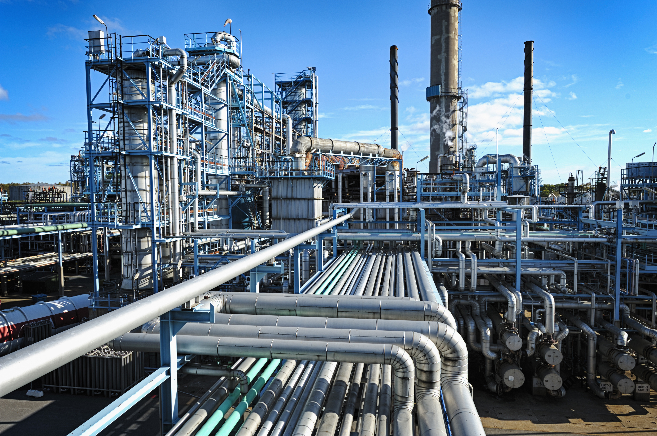
Industry Quotes…
“Feedstocks are dynamic, even in storage”
“Gremlins exist in these feedstocks”
“Heat, water, and oxygen will drive rancidity”
“Significant corrosion exists in the vapor phase”
“Material selection is critical due to high corrosion mechanisms”

Slide 28
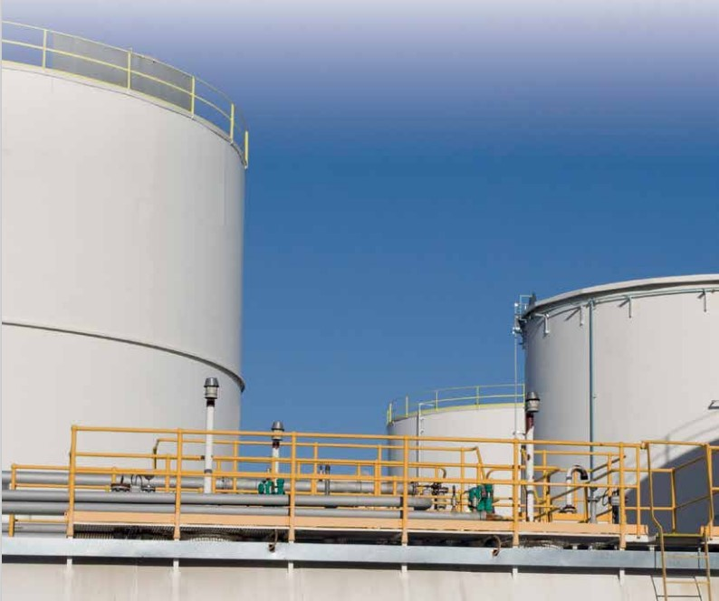
Thank You!
The use of polymeric coatings in storage and handling (before processing) as well as pretreatment:
Problematic areas where non-metallics may be a solution
Current coatings used in biofuels Railcars, Storage tanks and Process vessels

