Slide 1
Renewable Hydrocarbon Biofuels Overview – Laws/Regulations and U.S. Government Perspective
Jeffrey Earl
Director of State Regulatory Affairs
Clean Fuels Alliance America

Slide 2
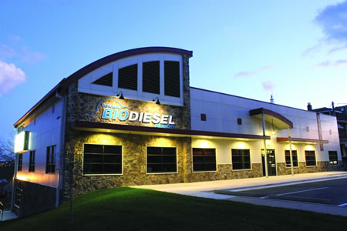
Our History
Founded by state soybean organizations using checkoff dollars to fund research with University Missouri
National SoyDiesel Development Board (1992)
National Biodiesel Board (1994)
Clean Fuels Alliance America (2021)

Slide 3
Mission
Representing biodiesel, renewable diesel, and sustainable aviation fuel, Clean Fuels Alliance America will advance the interests of its members by supporting sustainable biodiesel, renewable diesel and sustainable aviation fuel industry growth. Clean Fuels serves as the industry’s central coordinating entity for technical, environmental, and quality assurance programs and will be the strongest voice for its advocacy, communications, and market development.

Slide 4
Vision
Biodiesel, renewable diesel, and sustainable aviation fuel will be recognized as mainstream low-carbon fuel options with superior performance and emission characteristics. In on road, off road, air transportation, electricity generation, and home heating applications, use will exceed six billion gallons by 2030, eliminating over 35 million metric tons of CO2 equivalent greenhouse gas emissions annually. With advancements in feedstock, use will reach 15 billion gallons by 2050.

Slide 5
State and Federal Policy Team
Floyd Vergara
Director of State Governmental Affairs
Kurt Kovarik
Vice President, Federal Affairs
David Cobb
Director of Federal Affairs
Paul Winters
Director of Public Affairs and Federal Communications
Jeff Earl
Director of State Regulatory Affairs
Steve Dodge
Director of State Regulatory Affairs
Kate Shenk
Director of Regulatory Affairs

Slide 6
State Policy
Midwest
Focused on supporting agriculture
Northeast/Mid-Atlantic
Bioheat® fuel mandates have been popular
West Coast
Policy efforts led by state soybean organizations and biodiesel producers
Future considerations for Low Carbon Fuel policies
Concern over attempts to ban liquid fuels
Work closely with home heating oil industry and Northeast biodiesel producers
Low Carbon Fuel Standard (LCFS) in California drives many aspects of state regulatory policy on the West Coast
Environmentally conscience states look to adopt carbon policies like the LCFS and Clean Fuel Standards (CFS)
Policy coordination with renewable diesel producers and other environmental groups
Midwest policymakers prefer incentives to boost production and retail consumption

Slide 7
States With Notable Biodiesel Policies
LEGEND
Low Carb Fuels Standard
Mandate - Fuel Use or Bioheat® Fuel
Tax Incentive – Sales/Income
Tax Incentive - Production
Fleet Requirement
Bioheat® Fuel Mandate
Policy not enforced
No major policy
Bioheat® Fuel Blending Incentive
Current as of 01/017/2022
Data from DOE Alternative Fuels Data Center and Individual State Statues
Notes:
Policies that are highlighted are not the ONLY policies states may have set in place

Slide 8
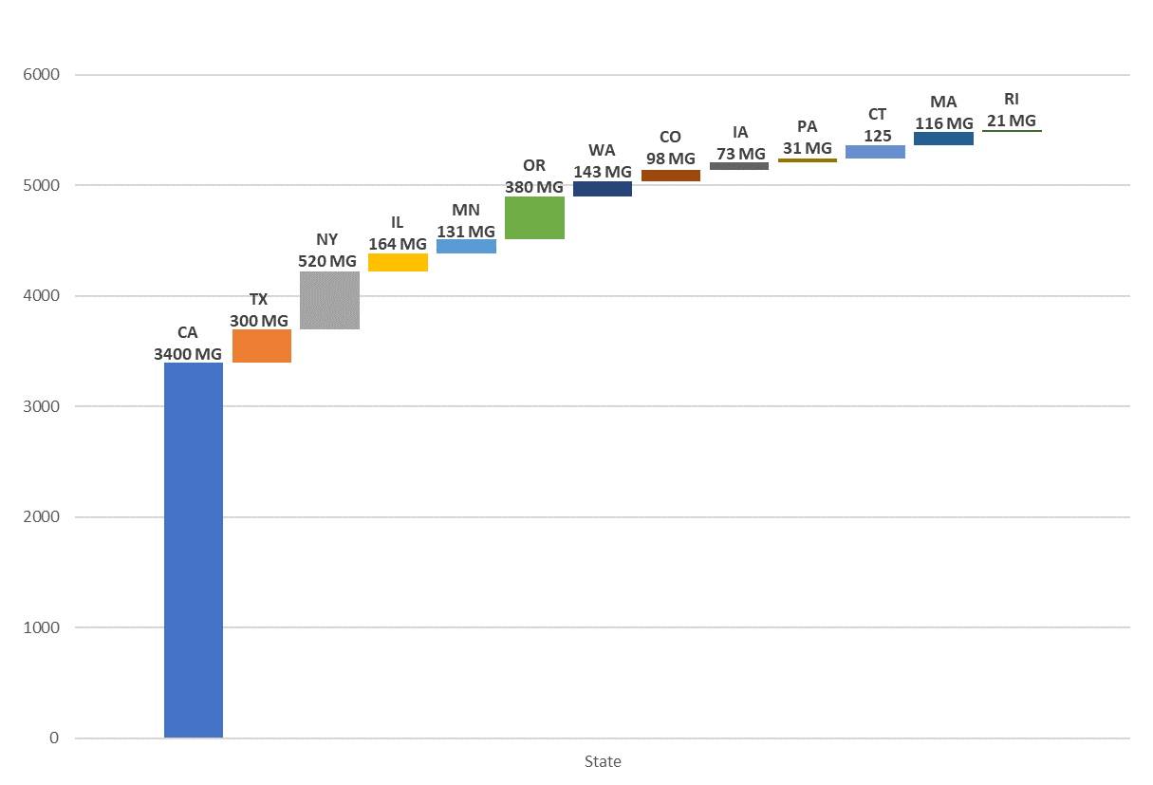
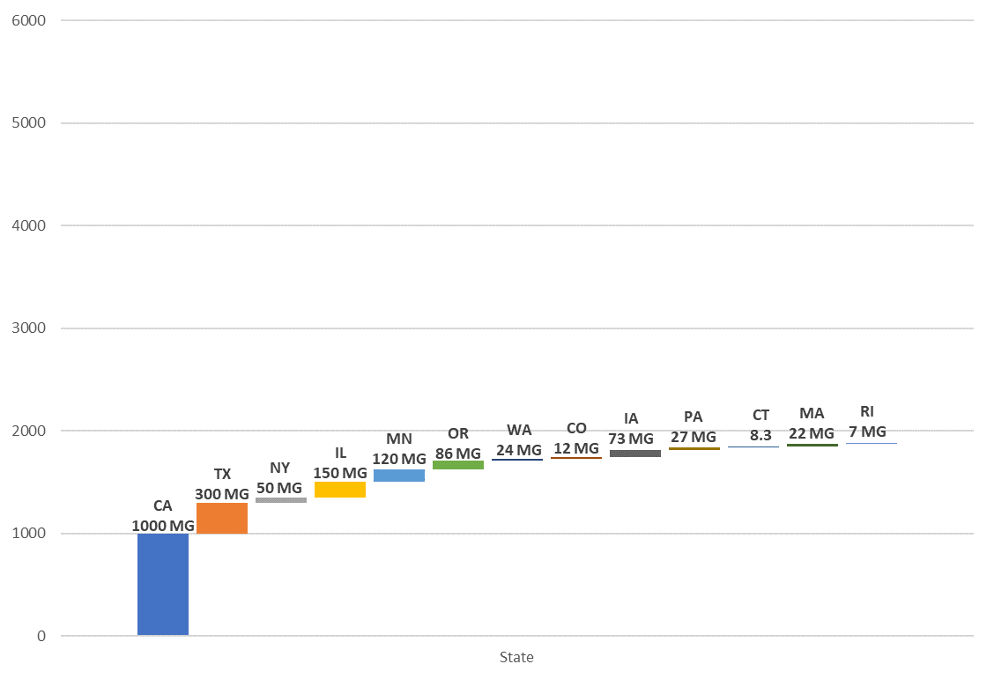
2020 1.9 Billion Gallon State Market
2030* 5.3 Billion Gallon State Market
*Potential growth based on established or proposed requirements

Slide 9
Midwest
Illinois
Iowa
Missouri
Increase sales tax exemption from B11 to B20 by 2026
Current incentive equates to about $.18 cpg
Signed into law on April 19th
Retail Tax Incentive
$.07 cpg for B20 to B29
Producers Tax Incentive
$.04 cpg
Legislation also contained other incentives for biodiesel
Signed into law on May 17th
Retail Tax Incentive
$.02 cpg for B5 to B10
$.05 cpg for B11+
$.02 cpg
$.05 cpg for B11 to B19
$.10 cpg for B30+
Governor has until July 2nd to take action
Producers Tax Incentive

Slide 10
Northeast/Mid-Atlantic
Bioheat® Fuel Mandates (2021)
Rhode Island – B50 by 2030
Liquid Fuel Bans
MA, CT, RI, NY, MD, & VT have considered legislation that would ban liquid fuels -including biodiesel and renewable diesel
Vermont Clean Fuel Standard
Connecticut – B50 by 2035
New York – B20 by 2030
RI, CT, & NY represent 40% of the heating oil market in the Northeast
Maryland Climate Solutions Now Act of 2022
Legislation requires state to achieve net-zero statewide greenhouse gas emissions by 2045
Clean fuels worked to include biodiesel into final version
Governor allowed to go into law without his signature
Would have established the first low-carbon fuel standard for heating fuels in the nation
Legislation was passed but vetoed by the Governor due to cost concerns
The VT Legislature failed to override the Governor by one vote

Slide 11
West Coast
States with LCFS/CFS
Clean Fuels continues to engage in rulemaking with state regulators to prioritize BMBD in carbon programs
OR and CA look to achieve additional carbon reduction goals
New Mexico Clean Fuel Standard
Rulemaking and Regulatory Efforts
California
Goal of reducing carbon intensity in transportation by 20% in 2030 & 30% by 2040
Oregon
Washington
One vote away from passing this year
LCFS – California
69% growth of biomass-based diesel (BMBD) since 2017
$4.4 Billion of credits generated
BMBD was 27% of the 2020 on-road diesel pool in CA

Slide 12
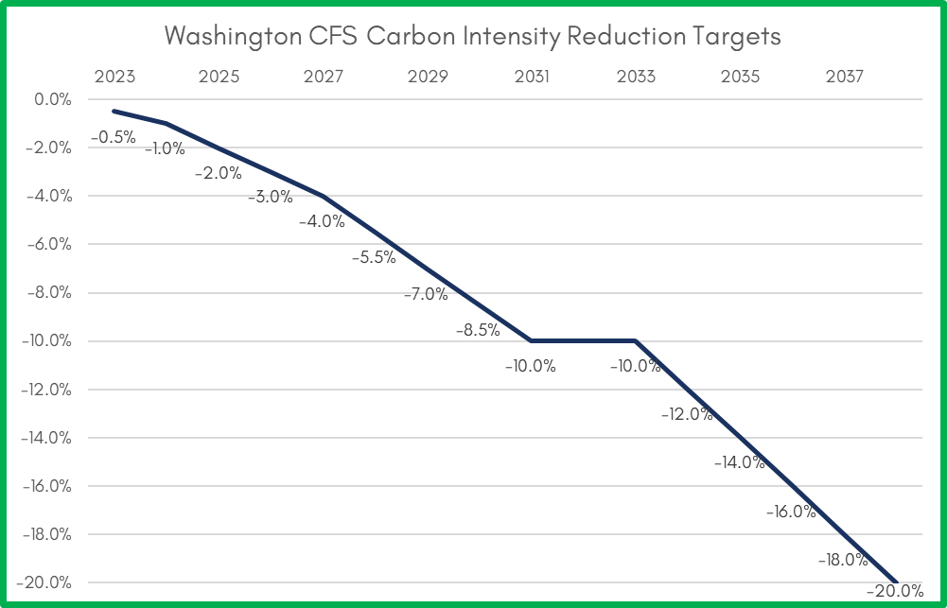
Washington State Clean Fuel Standard (CFS)
10% CI reduction by 2031, 20% by 2038
0.5% annually 2023-2024
1.0% annually 2025-2027
1.5% annually 2028-2031
2.0% annually 2034-2038
Mid-program review (‘31-’33)
950 Mgal diesel market
Rulemaking completion late 2022

Slide 13
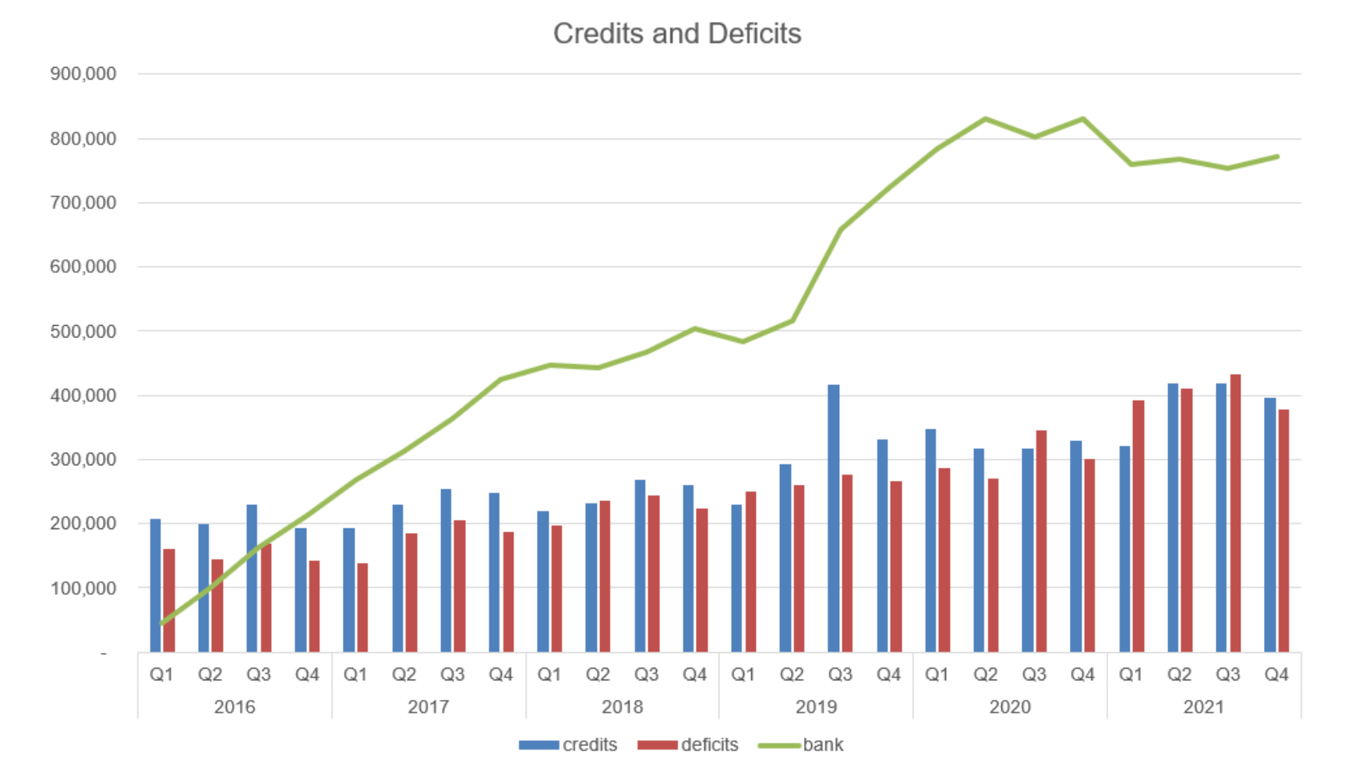
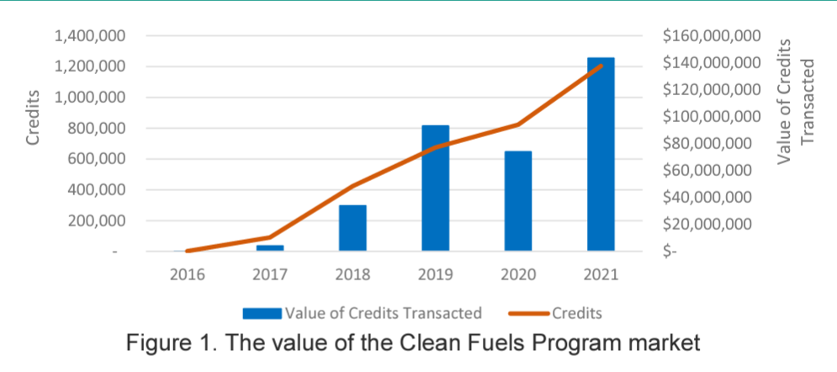
Oregon Clean Fuel Program (CFP) - Status
Implemented since 2016
100% virtually every quarter
760 Mgal/yr diesel fuel market
BMBD key role in program (single biggest source of GHG reductions in CFP)
88 Mgal BD/RD (2020), 11% blend
105 Mgal BD/RD (2021, forecast), 13% blend
136 Mgal BD/RD (2022, forecast), 17% blend
48% of credits in 2020, 54% in 2021 (forecast)
CFP credit value = $140M (2021)
BMBD credit value = $0.79 - $1.16 /gal

Slide 14
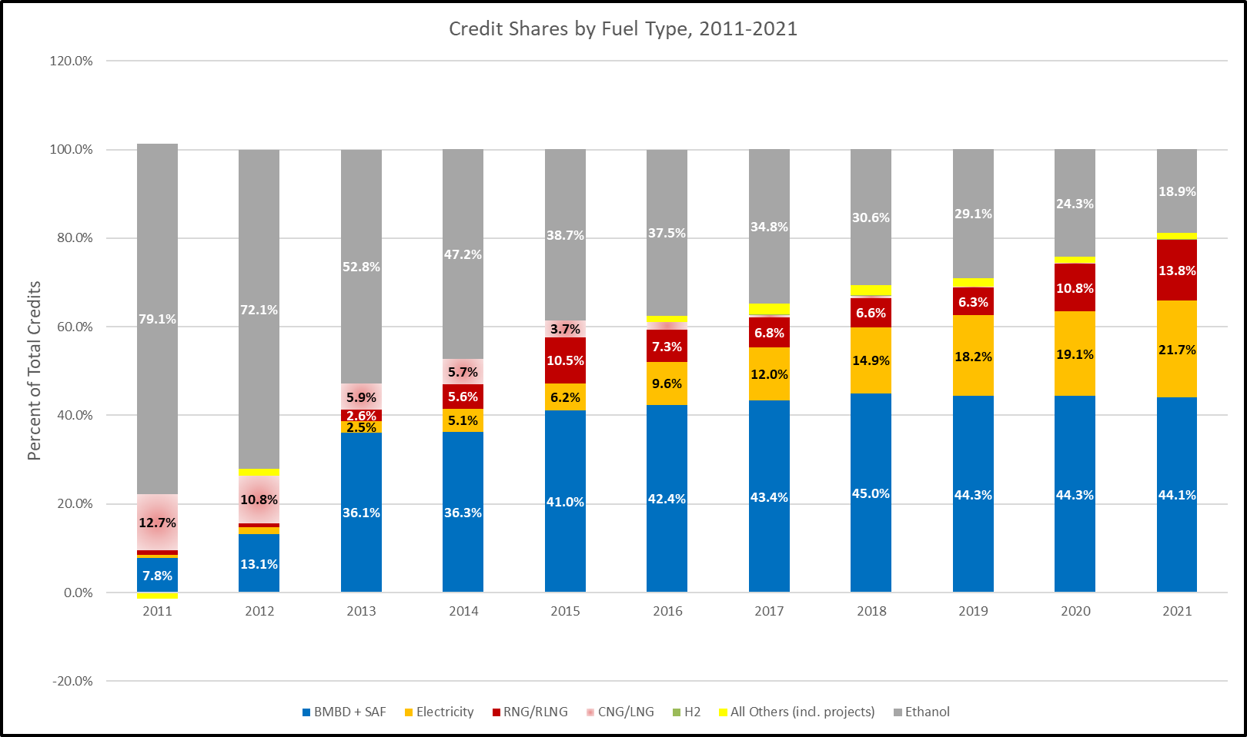
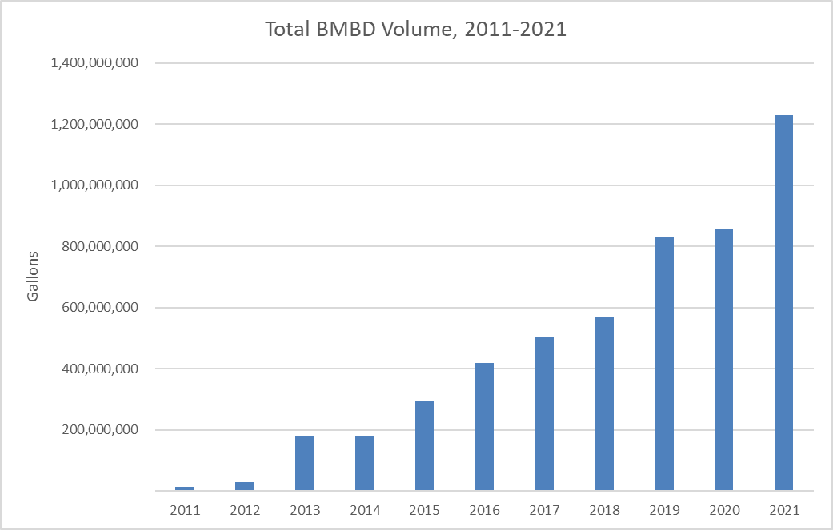
Drop-In, Low Carbon BMBD Translates to Critical Role in LCFS
1.23 Billion gallons!
(33% of diesel pool)
BMBD ~45% of Carbon Reductions

Slide 15
$4.4B BMBD LCFS Credits Generated 2011-2020
6.8M credits generated in 2020 valued at $1.34 Billion (at $199/credit)
$4.44B credits since 2011
~$1.60/gal value from credits

Slide 16
Federal Policy Priorities
Tax and Clean Energy Policy - Blenders Tax Credit
$1 per gallon credit for blending biodiesel and renewable diesel
Renewable Fuel Standard (RFS)
Requires growing volumes of biofuels to be blended with U.S. transportation fuels
Biodiesel Fair Trade
Maintaining trade protections against unfairly subsidized and dumped biodiesel imports
RFS Small Refiner Exemptions
Oppose retroactive exemptions, which reduce RFS biomass-based diesel volumes
Infrastructure
USDA programs help build markets and increase consumer access to biodiesel through infrastructure grants
Addressing Carbon
Collaboration with federal agencies to highlight biodiesel’s innovated role addressing carbon emissions

Slide 17
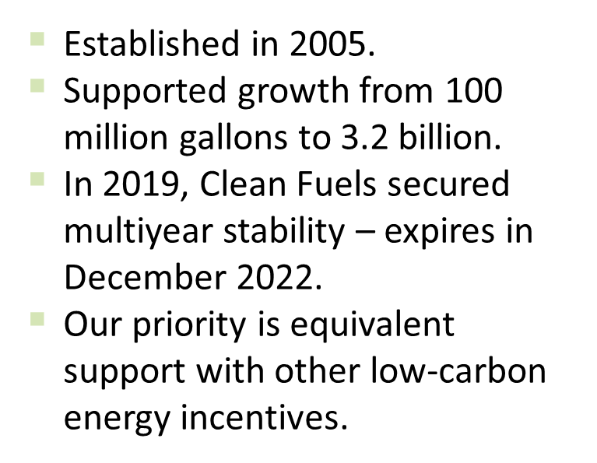
Blenders Tax Credit

Slide 18
Blenders Tax Credit
Impact the program has had:
The credit supports farm value – adds around $2 per soybean bushel
In 2020 and 2021, certainty helped the market grow by 200m gallons per year
Valuable environmental intensive on average
74% less carbon intensive on average
For every gallon, the industry provides $3.89 in environmental and economic value

Slide 19
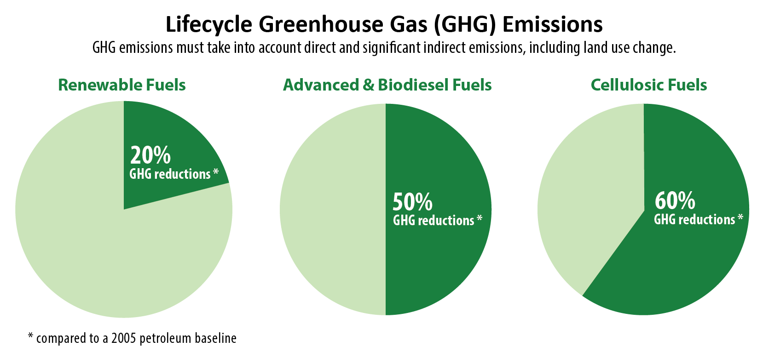
Renewable Fuel Standard
Expanded in 2007 to include advanced biofuels like biomass-based diesel.
Obligates refiners and importers to blend biofuel into gasoline and diesel.
Credit for renewables in heating and jet fuel.
Established buckets of biofuel in a nested demand structure, based on:
% GHG reduction.
Feedstock.

Slide 20
European Regulatory Framework for Renewable Hydrocarbon
Renewable Energy Directive II (RED II)
Updated in 2016
Overall EU target for Renewable Energy Sources consumption by 2030 raised to 32%.
Member States must require fuel suppliers to supply a minimum of 14% of the energy consumed in road and rail transport by 2030 as renewable energy.
Renewable diesel specification
Biodiesel specification
Key Differences
Agriculture feedstocks meet RD/BD spec but are excluded from the program
Europe first started producing biodiesel with rapeseed as its main feedstock

Slide 21
Biodiesel and Renewable Diesel

Slide 22
Renewable diesel is chemically the same as petroleum diesel, but made from renewable feedstocks
Renewable Diesel Properties
Pretreatment Unit
Property | Result | Units
API Gravity | 50 | API
Specific Gravity | 0.78 | SG
Sulfur | 0.1 | PPM
Nitrogen | <0.01 | PPM
Oxygen Content | 0 | Wt%
Aromatics | <1 | Wt%
Flash Point | >160 | °F
Cloud Point | -4 to 20 | °F
Cetane Index | >90 | -
Deoxygenation
Reactor
H
2
Feedstocks
Separation
Isomerization
Product Separation
Animal fats, used cooking oil, inedible corn oil, and soybean oil
Water
Light Fuels/ Propane
Renewable Naphtha
Renewable Diesel
Source: Darling Ingredients

Slide 23
US Biodiesel & Renewable Diesel Consumption

Slide 24
Renewable Diesel Feedstocks

Slide 25
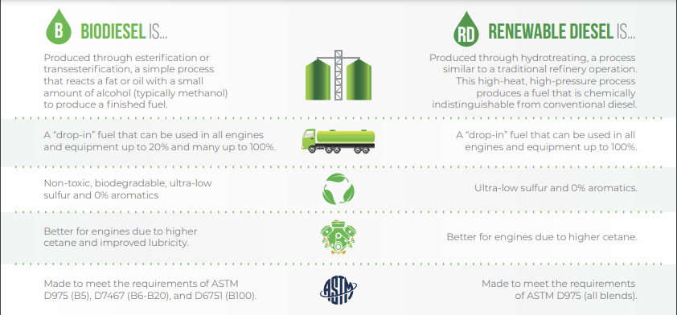
Biodiesel & Renewable Diesel

Slide 27
Questions

Slide 28
Thank you!
Jeff Earl – jearl@cleanfuels.org

