Slide 1
Damage Mechanisms in Pretreatment and Biofuels Processing Units
Matthew K. Caserta. P.E.
Becht

Slide 2
Overview
Introduction
Pretreatment Units
Expected Damage Mechanism
Fatty Acid Methyl Esters (FAME)
Expected Damage Mechanisms
Hydrodeoxygenation
Expected Damage Mechanisms
Support Units
Expected Damage Mechanisms

Slide 3
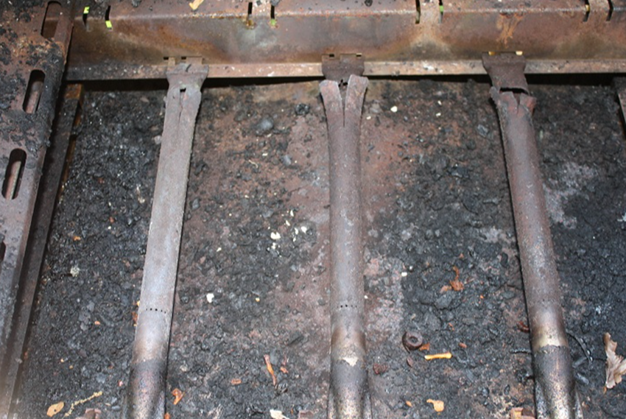
Bio-oils Corrosion?
Brand New Grill
Corroded Burners a Year Later
Notes:
Animal fats dripping on the burner can cause corrosion
Possibly this is also caused by salt from the meat

Slide 4
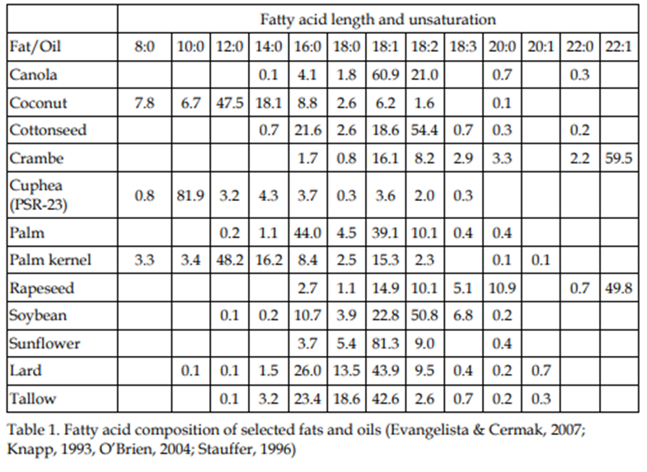
Bio-oils Corrosion?
Free Fatty Acids
Free Fatty Acids are building blocks of the lipid and thus are also a breakdown product of the original oil
Great for making fuels if you can get them processed while still inside the pipes
Notes:
Looking at this chart from the USDA, you can see that the animal fat and vegetable oils have fatty acids in a range of longer hydrocarbon chains. The animal fats are in a relatively narrow band but the vegetable oils vary widely.

Slide 5
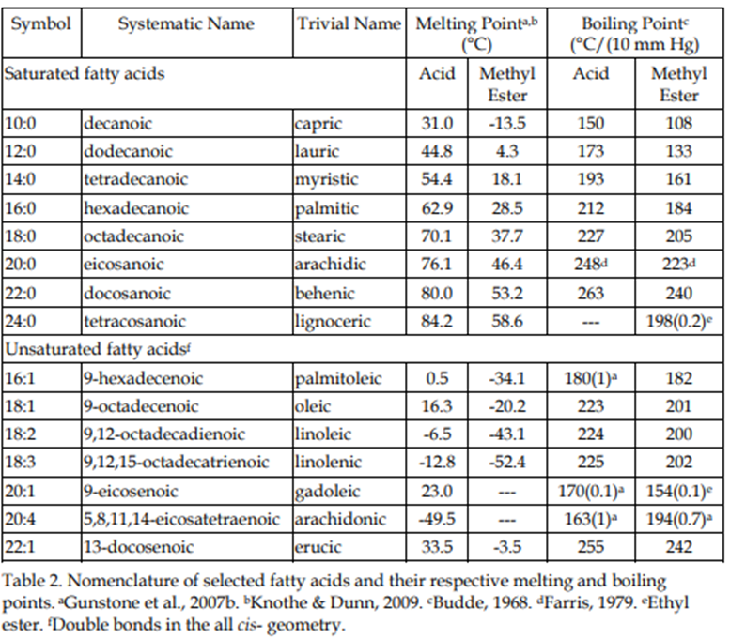
Bio-oils Corrosion?
We know that corrosion with organic acids is expected to be the worst at the boiling point and decomposition point.
The boiling points of the acids range from 302F to 505F.
This gives us an idea of where to look for corrosion.
Notes:
It lists the melting point and we may use this for minimum temperatures in the front end equipment to keep the fluids flowing. The important information is the boiling point of the acids. Note that the boiling points are shown under vacuum. Some FFAs will vaporize in the Feed/Effluent system, while some will stay as liquids.

Slide 6
Bio-oils Pretreatment
Crude bio-oil can be subjected to additional processing, with some of the possible steps being:
Degumming (with hot water or acids, removes lecithin)
Alkali refining (treatment with caustic to neutralize free fatty acids followed by water washing to remove the soaps thus produced)
Bleaching and filtering (acid treated clay media to remove color agents)
Winterizing (chilling and centrifuging to remove wax crystals)
Deodorizing (steam distillation to remove remaining free fatty acids and other contaminants)
Many of these processes are completed prior to purchase before conversion to renewable fuels. However, less processed feedstocks are cheaper to purchase, leading some plants to perform pretreatment inhouse
Notes:
Distillers Corn Oil (DCO) or Soybean Oil need to be processed before consumption. The same impurities that are removed before humans consume oils also need to be removed before conversion into biofuels. Color agents, gums, waxes, metals, phosphorus are examples
Also note that many of these processes are done in batch operations in the food processing industry. Continuous processes are under development to better suit refining processes

Slide 7
Bio-oils Pretreatment Processes
Water Degumming
Phospholipids in feedstocks can cause emulsions making processing difficult in downstream units
Gums are hydrated using a steam process and then removed by centrifuge or other separation method as the hydrated gums are not soluble in the oil
Expected Damage Mechanisms
Hydrated gums can form deposits causing under-deposit corrosion in storage vessels
Vessels used for the degumming process are often stirred reactors which can cause erosion

Slide 8
Bio-oils Pretreatment Processes
Acidic Degumming
Not all gums are able to be hydrated and acid treatment may be required
Acid Degumming can be used on High FFA Crude Oils where acid washing is followed by water washing to ensure gum removal
This process typically needs higher temperatures and long residence times.
Expected Damage Mechanisms
Common acids used are sulfuric acid or phosphoric acid. Acidic corrosion can occur
Chlorides incoming with feed can cause chloride stress corrosion cracking
Notes:
Water washing may or may not happen after the acid treating.
Due to evelated temperatures, carbon steel components are not recommended. Stainless steels can be used, but concern should be taken for chloride SCC

Slide 9
Bio-oils Pretreatment Processes
Alkali Degumming
In cases with high sodium and/or phosphorus of incoming feedstocks, acidic treatment can be followed by caustic neutralization
Raising the pH allows further separation of sodium and phosphorus
Caustic addition needs to be limited to prevent formation of soaps
Expected Damage Mechanisms
Caustic concentrations are typically low enough for caustic SCC to not be a concern. However, some processes are heated, and consideration for the caustic SCC curve would be needed
Caustic corrosion is not likely based on low concentrations added
Notes:
Typical caustic treatments are less than 1 wt.% of the total solution.
Caustic SCC is not likely to occur with that low of a concertation. However caustic concentrating during outages or during steam out could cause issues.
Acidic treatments would cause similar damage mechanisms as noted earlier

Slide 10
Bio-oils Pretreatment Processes
Winterizing
A further step in the degumming process, acidified and then neutralized oils are chilled below 40F
Waxes and other high melting point components are solidified
Solids are then separated by mechanical means
Expected Damage Mechanisms
Damage mechanisms are similar to previous degumming operations
Solids can cause erosion, depending on the separation method
Notes:
I have not seen a winterizing step used by refiners upstream of an HDO unit. Some of the purchased feedstocks used have already had this step completed

Slide 11
Bio-oils Pretreatment Processes
Bleaching
Mixing of oil with a clay adsorbent to remove color
Bleaching operation removes some of the color, reduces the contents of chlorophyll, residual soap and gums, trace metals, oxidation products
Bleaching clays are activated via interaction with acids
Expected Damage Mechanisms
Acidic corrosion is possible when activating bleaching clays. pH is commonly in the range of 2. Stainless steels are commonly used for process equipment
Stirred reactors are common in this process leading to potential erosion of slurry streams.
Notes:
Stirred reactors are common in food processing facilities for bleaching. Bleaching can be done in fixed bed media vessels and leg/lag operations to make the process more continuous. Clays would have to be regenerated over time and acids introduced into the process.

Slide 12
Bio-oils Pretreatment Processes
Deodorizing
Deodorization is stripping process that typically uses steam above 400°F
Physical process in which volatile components are removed
Often completed under vacuum
Expected Damage Mechanisms
Light organic acids in the overhead can lead to acid sour water in the vacuum system
Notes:
Steam stripping is typically done by direct injection into the oil. Proper design of the steam injection is necessary to prevent erosion

Slide 13
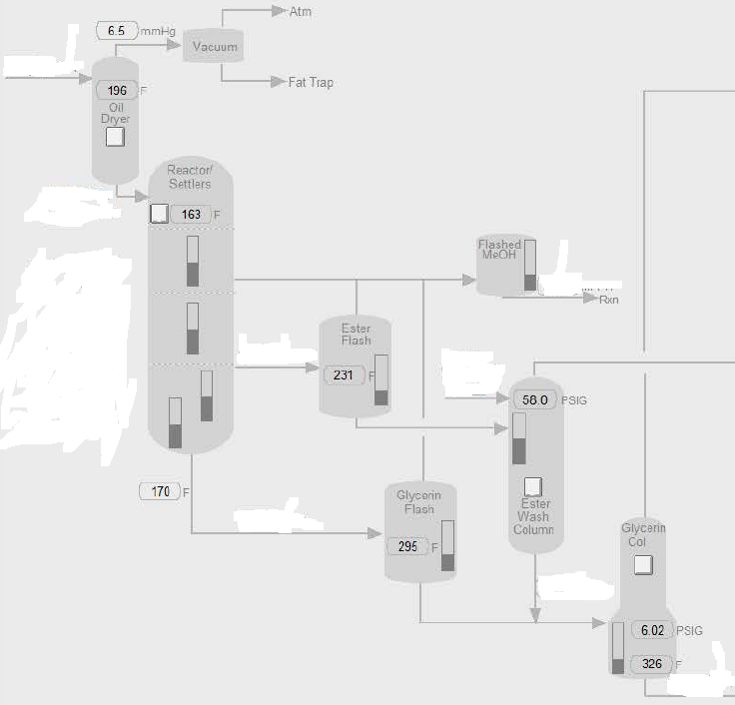
Fatty Acid Methyl Ester (FAME)
FAME is produced from vegetable oils, animal fats or waste cooking oils by transesterification.
In the transesterification process a glyceride reacts with an alcohol in the presence of a catalyst, forming a mixture of fatty acids esters and an alcohol, typically methanol.
Using triglycerides results in the production of glycerol.
Notes:
Prior to the recent push for hydrodeoxygenation, the transesterification process was used to covert bio-oils to transportation fuels. This process has been around for many decades.
The created FAME is much less stable for storage than biofuels created in an HDO unit. Refiners have also been able to convert existing hydrotreating assets into HDO units with minimal capital investments. However, there are many FAME units still in operation around the world.

Slide 14
Fatty Acid Methyl Ester (FAME)
Free Fatty Acid Corrosion
FAME process is relatively low temperature and FFA corrosion is not expected to be severe
Caustic Corrosion/Cracking
Sodium hydroxide is reacted with methanol to form sodium methoxide. Alkaline corrosion and SCC is possible in higher temperature sections of the unit
Methanol Corrosion
Corrosion potential in methanol streams are low. Methanol/water mixtures can experience corrosion, especially in the presence of oxygen.
Methanol SCC
Stress Corrosion Cracking can occur in as-welded carbon steel in methanol solutions that contain between about 0.05% water and 1% water and dissolved oxygen

Slide 15
Hydrodeoxygenation
Notes:
Standard hydrotreater; use of the product recycle to minimize reaction temperature rise
Amine treating is typically needed for co-processing. May also be needed for CO2 removal from recycle gas, but the H2S production is minimal due to low sulfur in feeds

Slide 16
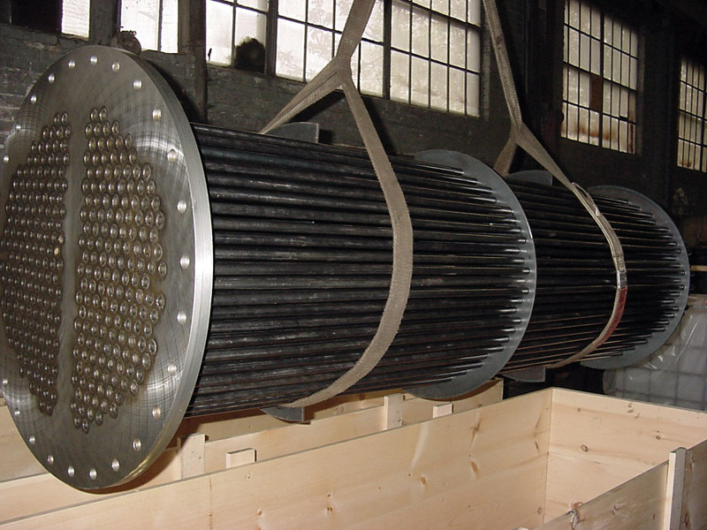
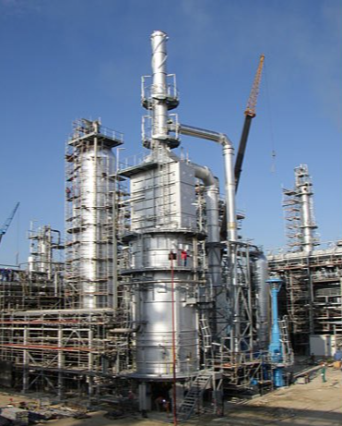
Feed Section Corrosion
Feed Effluent Exchangers
Typically, the unit feed is less than 300°F when it enters the exchangers and over 500°F when it leaves them.
The feed side tube wall of the feed/effluent exchangers will reach the fatty acid boiling point.
Charge Heater
The concern in charge heaters is decomposition of the fatty acids to light organic acid that should begin above 650°F.
Bulk process temperature may be below the decomposition temperature, but the tube metal may be high enough.
Notes:
The lipid oil may not be heated but can be mixed into the preheated hydrogen and recycle oil

Slide 17
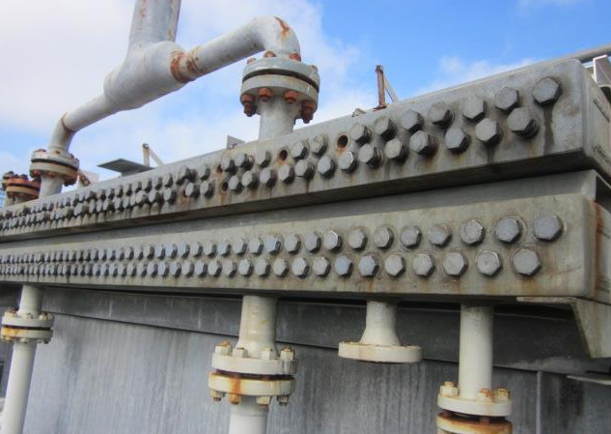
Reactor Effluent System
Feed Effluent Exchangers, Piping, Water Wash Injections, REACs, Separators
NH₄Cl salting corrosion and NH₄HS aqueous corrosion still primary corrodents
Increased water content in effluent due to increased oxygen in feeds lead to significant difference in salting corrosion and dew point profile in effluent.
Impact risk to dead legs and corrosion upstream of water wash injection.
Potential ammonia / CO₂ based salt formation primarily fouling concern with some corrosion risk.
Notes:
Water wash is at a much higher temperature because the NH4Cl salt point is higher
About 10% of the feed ends up as water. Huge amounts of water compared to conventional hydrotreating. Any NH4Cl upstream of the water wash will be corrosive because of the higher humidity, a big difference from a typical hydrotreater

Slide 18
Separation Section
Additional water make may create water separator issues including water boot and drain valve size.
Water carryover may be a start up issue in a retrofitted unit.
Water may be more acidic than alkaline with the addition of CO₂.
Separator vapor space will be much higher in CO₂ and lower in H₂S.
Dew point corrosion in the system may have a different morphology and location than you would expect in a hydrotreater.
Stripper overhead temperature may need to be modified to prevent fouling.
Notes:
Predictions of pH using OLI have been in the 4 to 5 pH range, for HDO units

Slide 19
Support Units
Amine Treating/Regeneration
Sour Water Stripping

Slide 20
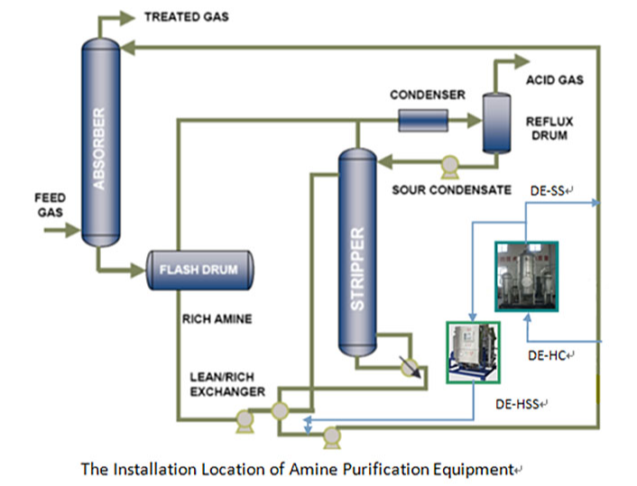
Amine Treating/Regeneration
Increased CO₂ levels in streams leads to significant impacts to amine system
H₂S selective amines formulations will allow treated streams to be higher in CO₂ with potential downstream CO₂ corrosion risks.
Significant potential for increased corrosion in amine regen:
Non-selective amines will see increased CO₂ acid gas loading in rich amine.
Degradation of selective amines will also see increased CO₂ acid gas loading in rich amine.
Increased light organic acids in product streams will increase heat stable acid salt formation.
CO₂ can be harder to strip in regeneration causing higher CO₂ levels in lean amine.
Higher CO₂ and HSAS levels can significantly increase corrosion risk of CS in hot lean amine.
Higher CO₂ in regenerator overhead can lead to increased acidic corrosion risk of CS.

Slide 21
Sour Water Stripping
Existing refinery sour water stripping units were designed for H₂S removal with limited CO₂ removal.
Increased CO₂ in the sour water can lead to more acidic overhead and higher potential for corrosion.
Wet H₂S and wet CO₂ are still risks within the system.

Slide 22
Summary
Selection of feedstocks and level of pretreating are important to determine future corrosion potentials
Modification of an existing refinery for co-processing or bio-feedstock comes with new corrosion risks
Mitigation may be through alloy selection, IOW control, or process control
Most of the damage mechanisms encountered are not new, they are just in locations we didn’t expect to see
Significant consideration to materials and corrosion must be given for a successful project.

Slide 23
References
Tafesh, A. and Basheer, S. Pretreatment Methods in Biodiesel Production Process. Pretreatment Techniques for Biofuels and Biorefineries, First Edition. Fang, Z. Springer.
Gunstone, F.D. and Harwood, J.L. Occurrence and characterisation of oils and fats. In: The Lipid Handbook (3rd edition), pp.37-142 (F.D. Gunstone, J.L. Harwood, and A.J. Dijkstra (eds.), Taylor & Francis Group, LLC, Boca Raton, FL) (2007).
Richard D. O'Brien, Soybean Oil Purification. Soybeans: Chemistry, Production, Processing, and Utilization, AOCS Press. (2008)
https://lipidlibrary.aocs.org/edible-oil-processing

